Slide 2

Knowing Jesus as My Life
“…Christ, Who is our life…”
Colossians 3:4

Slide 3
What Identity are You Living Out of?

Slide 4
Who are you?

Slide 5

God Created Us with a:
Spirit to relate to God, a Soul (Mind, Emotions and Will) – Personality, to relate to people, and we live in a Body!
Our Body and Soul are not who we are.
We are Spiritual beings!
Body
Soul
Spirit

Slide 6
What A Great Relationship:
God created Adam and Eve and provided everything they could ever need or want, and they experienced a life of fullness, abundance and fruitfulness in a relationship with God that would be totally dependent on Him.

Slide 7
Why Do We Not Know Who We Are - Our Identity?
God told Adam and Eve, “you must not eat from the tree of the knowledge of good and evil, for when you eat of it you will surely die.” Gen. 2:17

Slide 8
God Offered Adam and Eve Eternal Life
Tree of Life = Dependence on God
Eternity Future Heaven
Eternity Past
Christ’s Life = Eternal Life
Eternity Present
Adam and Eve
Tree of the Knowledge of Good and Evil = Independence from God
God wanted children who would live dependent on Him because they chose to do so, not because they had to, so he gave Adam and Eve a choice.

Slide 9
Satan’s Great Deception:
The choice was not between Good or Evil because they are both evidence of an attitude of independence from God.
Evil is clearly rebellion against God (everything from telling a lie to committing mass murder) but,
Good is not so obvious (Trying to live for God in my own strength) is just as wrong and displays the same attitude of independence from God.

Slide 10
A Great Loss:
Satan convinced Adam and Eve to choose to disobey God by eating from the Tree of the Knowledge of Good and Evil and live independent from God.
Satan told Eve “you will be like God”.
Their identity of who they were in a relationship with God was lost and now all humanity longs to know their identity!

Slide 11

Adam and Eve Chose Independence from God
Eternity Future Heaven
Eternity Past
Christ’s Life = Eternal Life
Adam and Eve
Eternity Present
Our future is to be separated from God forever =
They died as God said
AdamThey chose to eat from the Tree of the Knowledge of Good and Evil. They chose Independence from God.
We are all born Dead to God and Separated From Him.
Hell
If your father died before he had any children – how would that have affected your life? You would have died physically in your father! Likewise you died spiritually in Adam. When he sinned you sinned – when he died you died!
“Therefore, just as sin entered the world through one man, and death through sin, and in this way death came to all men (Mankind), because all sinned …” Romans 5:12

Slide 12
Independence from God is Sin
Eternity Future Heaven
Eternity Past
Christ’s Life = Eternal Life
Eternity Present
Adam Died = You are Dead to God
Separated From God
Hell
Because we are born a desendant of Adam: We are sinners by nature, therefore, we commit acts of sin. You see - we are not sinners because we sin, no - we sin because we are sinners.
“for all have sinned and fall short of the glory of God,…” Romans 3:23

Slide 13
What Died
Adam and Eve ate in disobedience to God, and as God said, they died! Did they die in their:
  Body? No - Adam lived 930 years.
  Soul (Mind, Emotions Will - Personality)? No -They still had a personality.
  Spirit? Yes - Their Spirit became dead to God, but, remained alive to Satan and to this world.

Slide 14
How did Jesus Restore Us to Our True Identity?
Jesus left Heaven to come to our world to redeem what Adam and Eve lost for all of humanity.

Slide 15
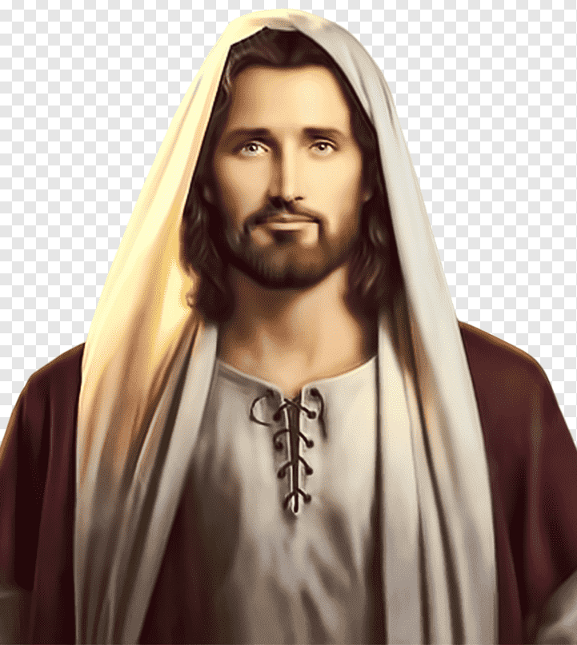
God Has Given Us Eternal Life
Eternity Future Heaven
Eternity Past
Christ’s Life = Eternal Life
Eternity Present
Adam and Eve
We are all born Dead to God and Separated From Him.
Hell
When we receive Jesus as our Savior we die to Adam’s Family and are born again into God’s Family.
But, “God so loved the world that He gave His one and only Son, that whoever believes in Him shall not perish but have eternal life.” John 3:16

Slide 16
God Has Given Us Eternal Life
Eternity Future Heaven
Eternity Past
Christ’s Life = Eternal Life
Eternity Present
Have you received Jesus?
Do you have the Son?
Do you know you have eternal life?
“And this is the testimony: God has given us eternal life, and this life is in his Son. Whoever has the Son has life; whoever does not have the Son of God does not have life. I write these things to you who believe in the name of the Son of God so that you may know that you have eternal life” 1 John 5:11-13

Slide 17
God Has Given Us Eternal Life
Eternity Future Heaven
Eternity Past
Christ’s Life = Eternal Life
Eternity Present
If you are not certain and would like to be certain
pray this prayer and receive Jesus as your Savior.
“Lord Jesus, I am a sinner, and I can not save myself. Thank you for dying on the cross for my sins. I now invite You into my life and receive You as my Savior and Lord. Thank You for forgiving my sins and giving me Eternal Life. I now give You control of my life and trust You to live Your Eternal Life through me as You please.”

Slide 18
God Has Given Us Eternal Life
Eternity Future Heaven
Eternity Past
Christ’s Life = Eternal Life
Eternity Present
Did you receive Jesus Christ?
Do you know your sins are forgiven?
Do you have the Son (Jesus)?
Do you know you have Eternal Life?
How do you know?
If you are not certain reread 1 John 5:11 to 13.

Slide 19
You are a Spiritual being. Your Spirit is Who you are.
When you received Christ, your Spirit was made alive with the Eternal Life of Jesus!
"The Spirit [of God] Himself bears witness with our spirit that we are children of God, and if children, then heirs—heirs of God and fellow heirs with Christ...” (Rom. 8:16,17a)

Slide 20
God Has Given Us Eternal Life
Eternity Future Heaven
Eternity Past
Christ’s Life = Eternal Life
Eternity Present
What does it mean to have Eternal life?
In our next session we will learn what Eternal Life is and how to live it.

Slide 22
Jesus as My Life
The Exchanged Life

Slide 23
God Has Given Us Eternal Life
Eternity Future Heaven
Eternity Past
Christ’s Life = Eternal Life
Eternity Present
Have you received Jesus?
Do you have the Son?
In the last session we learned that we can know we have Eternal Life if we know we have the Son (Jesus).
Do you know you have eternal life?
“And this is the testimony: God has given us eternal life, and this life is in his Son. Whoever has the Son has life; whoever does not have the Son of God does not have life. I write these things to you who believe in the name of the Son of God so that you may know that you have eternal life” 1 John 5:11-13

Slide 24
What is Eternal Life?
Eternal Life is the kind of life that God has with no limitations of any kind.

Slide 25
Jesus is God:
Jesus said in John 10:30; “I and the Father are ONE”.
Jesus was claiming to be God!

Slide 26
Read John 17:20-23.
Jesus is praying to the Father for all those who would be His followers.
He said, “I pray… that all of them (Followers/Believers) may be one, Father, just as you are in me, and I am in you. May they also be in us …

Slide 27
Jesus is saying that because the Father is in Jesus and Jesus is in the Father – that they are ONE.
Then Jesus also prayed for us His Followers;
‘‘May they also be in Us”.

Slide 28
If Jesus and the Father are ONE and the Father and Jesus are ONE with Us, then does that mean that God is ONE with Us?
How Can That Be?
My spirit is who I am and through Adam’s disobedience my spirit became dead to God, so how can God be ONE with me?

Slide 29
God cannot be ONE with my old dead spirit!
My dead spirit had to be eliminated!
How?
The Apostle Paul answered this.
He wrote of his old dead spirit in Gal. 2:20. He said;
“I have been Crucified With Christ,
and I no longer live,
but Christ lives in me”.
Risen with Jesus to live a new LIFE
- His Eternal LIFE
JESUS
Crucified with Jesus
Buried with Jesus

Slide 30
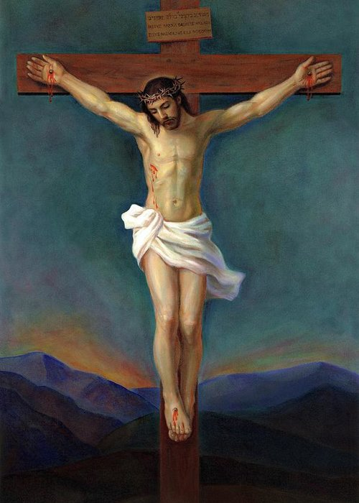
How Could You be Crucified with Jesus? He was crucified over 2000 years ago!
Eternity Past
Eternity Future Heaven
Eternity Present
When you received Christ as your Savior:
God forgave all your sins and placed you in His Son! 1Peter 3:18
Jesus is God the Son, He is an Eternal Being! John 10:30
Because you have the Son you have Eternal life! 1 John 5:10-13
You are a Partaker of God’s Divine Nature! 2 Peter 1:4
Eternal Life is not limited by time or space.
So, when Jesus died on the cross you died with Him. Gal. 2:20

Slide 31

How Could You be Crucified with Jesus? He was crucified over 2000 years ago!
Where is Christ?
Eternity Past
Eternity Present
Eternity Future Heaven
You are ONE with Jesus Christ:
You are a new creation in Christ. 2 Cor. 5:17
Jesus is living in you in all you do. Col.3:4
You are seated in Him in heaven with the Father. Ephesians 2:6
You are in Jesus Christ Eternally. (Past, Present, and Future)
You died with Jesus on the Cross, were buried with Him, and Raised-up with Him to live a new life – Jesus’ eternal life! Gal.2:20
You are in Christ! Christ is in you!

Slide 32
You and I Are Crucified With Jesus Christ
If you have received Jesus Christ as your Savior, then what is true of Paul in Galatians 2:20 is also true of you.
Whether you understand it or not – it is true.
Whether you feel like it or not – it is true.
Whether you act like it or not – it is true.
Whether you believe it or not – it has been done!
Like Paul You were crucified with Jesus!

Slide 33
Does this mean that we do nothing or that we have been annihilated and no longer have a life or an identity?
No! Like Paul we continue to live, but now we live by faith that by Jesus’ life in us and by the Holy Spirit empowering us, we will live and be used by God for His glory!

Slide 34
You are a Spiritual being. Your Spirit is Who you are!
When you were crucified with Christ, what got crucified?
Your spirit that was dead to God was put out of business and was exchanged or replaced with the very much alive Eternal Life of Jesus!

Slide 35
As Paul goes on to say in Galatians 2:20;
…The life I live in the body, I live by faith in the Son of God, who loved me and gave himself for me.”

Slide 36
In John 17:21
Jesus said; “…May they also be in us so that the world may believe that you have sent me…”
How will they believe the Father sent Jesus?
They will see Jesus’ eternal life in us not our inadequate life and be drawn to Him.

Slide 37
What will they see?
In John 17:22 Jesus said;
…I have given them (His Followers) the glory that you (Father) gave me,

Slide 38
What is the glory that they must see to know and believe?
The character of God. For Example (in Galatians 5:22-23):
The fruit of the Spirit.
“love, joy, peace, patience, kindness, goodness, faithfulness, gentleness, and self-control”,
When the world sees Spiritual fruit displayed in us;
they will want Jesus’ life also.

Slide 39
Personalize Galatians 2:20
If you are willing to do so, read out loud the following verse putting your own name in the blank spaces.
“I _____ have been crucified with Christ and _____ no longer lives, but Christ lives in _____. The life _____ lives in the body, _____ lives by faith in the Son of God, who loved _____ and gave Himself for _____.
Repeat this verse with your name in it each day this week.

Slide 40
How Can I Live a Life With Power?
In the next session we will look at where the power comes from to produce Spiritual Fruit in us and to be Empowered for Spiritual Ministry.

Slide 42
Living by the Spirit
Living Out the New Life Within!

Slide 43
Living by the Flesh or the Spirit
Knowing we are in Christ and no longer in Adam we must learn to live by the Spirit and not by the flesh. Romans 8:9
The flesh is linked with Adam’s life that was energized by Satan. You are now dead to that life.
The Spirit is God’s life within you that enables and empowers you to live like Jesus Christ.

Slide 44
The Law of the Spirit of Life
“Therefore, there is now no condemnation for those who are in Christ Jesus, because through Christ Jesus the law of the Spirit of life sets me free from the law of sin and death” Romans 8:1,2

Slide 45
How God Has Made Us
We live in a body that relates to the world
Body
We have a soul (personality) that relates to people
Soul
Spirit
Taste
Mind
Will
Smell
We are a spirit so we can relate to God
Emotions
Touch
Sound
Sight

Slide 46
How We Become Alive to God
God
When we receive Jesus Christ, He dwells in us - our old dead spirit is exchanged or replaced with the life of Jesus and is empowered by the Holy Spirit. Gal. 2:20
Body
“…the one who joins himself to the Lord is one spirit with Him.” 1 Corinthians 6:17
Through Adam’s disobedience our spirit became dead to God
Soul
Old Dead Spirit
Taste
Mind
Will
Smell
Jesus
Emotions
Touch
Sound
Sight

Slide 47
How God Directs Your Life
When you allow God the Father, through the life of Jesus to direct you by choosing to think according to His Word, your Mind will be renewed (Romans 12:2).
Your renewed mind will affect your Emotions replacing fear and suspicion, etc. with love, joy, peace, etc. (Galatians 5:22,23).

Slide 48
In this frame of mind, you Will (or choose) to do actions (through your physical body) that will result in works of righteousness.
These actions, empowered by the Holy Spirit will please God and display the glory of God.

Slide 49
How God Directs Our Lives
God
As we get to know Jesus through reading the Bible and Prayer our minds will be renewed.
Body
Soul
Taste
Mind
Will
Smell
Jesus
Through our physical body
Emotions
Touch
Sound
Sight
Resulting in Works of Righteousness

Slide 50



The life we chose determines how we relate to each other
Communication Given and Received
= Our Old Dead Spirit
= Jesus’ Eternal Life
Discord =
Peace/Harmony =
(Love, Joy, Peace etc.)
Self
Self
Self
Jesus
Discord Both Ways
Jesus
Self
Peace Given Discord Received
Discord Given Peace Received
Example: If Jesus is your life, and Jesus is the life of your Spouse or Friend, would you talk to each other the way you do?
Jesus
Jesus
Peace/Harmony Both Ways

Slide 51
How Satan Seeks to Direct Our Lives
Satan, who is the source of all evil, cannot affect our new Spirit which is Christ empowered by the Holy Spirit, so he operates through the world system - greed, power, lust, fear and pleasure etc.
He tempts us through our fleshly desires to choose to disobey God (Just like with Adam and Eve). Our senses can be aroused because we still have habits and memories of sin’s pleasures.

Slide 52
Our mind, which is in the process of being renewed, is still vulnerable and will at times believe Satan’s lies. We are free to choose to live for our own glory and pleasure, but to do so, we sin and dishonour God.
This of course, pleases Satan who is the enemy of God.

Slide 53
How Satan Seeks to Direct Our Lives
God
Satan can not effect our Spirit that is the Life of Jesus, so he uses the World System.
Body
Soul
Taste
Mind
Will
Smell
Fleshly
Desires
Jesus
Emotions
World System
Touch
Sound
Resulting in Works of Unrighteousness
Satan
Sight

Slide 54
You are still in your Body, you still have a Soul (Mind, Emotions and Will) so you still have the freedom (free will) to choose to live as who you were before you received Christ as your Savior, but to do so is to live as someone you are not – someone you used to be but no longer are!

Slide 55
I may even try to do my Best for God, but it will not do!
The best I can do would be like a small plastic replica of the real thing – Jesus’ life!
Like a plastic model of a fighter jet. It can sit on my desk and look like a fighter jet, but it can’t fly and has no fighting power.
It is a poor representation of the real thing!

Slide 56
Trust the Holy Spirit
Living in the Spirit means that I trust the Holy Spirit to guide me, and to do supernaturally in me and through me what I cannot do myself.
This life is completely different from the life I would have lived out of my old inadequate self.

Slide 57
Set Apart for the Lord
There must be a day in my life when I pass out of my own hands into His,
and from that day forward I belong to Him and no longer to myself. Romans 12:1,2
Would someone like to share
with us their Story of that day?

Slide 58
Discover Spiritual Family on Mission
In our next session we will look at what it would
be like to be in a Spiritual Family on Mission.
Pray this week that God will direct and encourage
you to grow as Jesus’ disciple in a Spiritual Family
and discover the blessings of being part of His
Special Family and the ministry we can do together.

Slide 60
Living by the Spirit
In a Spiritual Family on Mission!

Slide 61
Discover Spiritual Family on Mission
God designed us to live in dependence on Him as we have seen in the previous sessions.
He also designed us - His Children to live interdependence on each other, and love each other as we learn together and use our Spiritual Gifts to serve each other.
God also called us to be a blessing to our community by showing the love of God through deeds of kindness and by sharing the good news of the gospel with them.

Slide 62
God’s Eternal Purpose is to Save a Lost World
“The Son of Man (Jesus) came to seek and to save what was lost” Luke 19:10
Jesus said:
“Father.. I brought You Glory on earth by completing the work You gave Me to do” John 17:4

Slide 63
Jesus Completed his Work:
Jesus could say to the Father that He completed the work that the Father gave Him to do because He knew exactly what the Father had given Him to do!
What has God given us to do?

Slide 64
God’s Command
“And this is His (the Father’s) command: to believe in the name of His Son, Jesus Christ, and to love one another as He (Jesus) commanded us.” 1 John 3:23

Slide 65
Jesus’ Command
“A new command I give you: Love one another. As I have loved you, so you must love one another. By this all men will know that you are my disciples, if you love one another.”
John 13:34-35

Slide 66
The world will know we are disciples of Jesus when they see how we love each other as family.
We must learn to love and care for each person in our Spiritual Family using the unique Spiritual Gifts God has given us.

Slide 67
All Healthy Living Things Grow
God has built into His creation the inherent capacity of healthy living organisms to grow and reproduce.
The Church is a living organism
Notes:
67

Slide 68
Principles of Growth
The Spiritual Family
► New Christian
New Christian ► Disciple ► Discipler ► Parent ► Disciple
► Discipler
(Baby)
(Child)
(Teen)
(Parent)
The Church should be a network of
Reproducing Spiritual Families
Not an Orphanage!
Notes:
68

Slide 69
Would You Like to be in a Spiritual Family Where You are:
Loved and loving one another as Christ loves us?
Excited to share the Gospel and introduce your friends to Jesus?
Equipped to reproduce and equipping other Believers?
Being genuinely transformed into a vibrant and fruitful disciple of Jesus Christ?
You can Experience such a Family!
Notes:
69

Slide 70
Jesus had a Spiritual family:
He loved them and they loved one another as Christ.
They were excited to share the Gospel and introduce their friends to Jesus.
Jesus equipped them to reproduce, and they equipped their disciples to make more disciples.
They were genuinely transformed from fearful fisherman into vibrant and fruitful disciples of Jesus Christ who went on to changed the world?
Experience a Spiritual Family like Jesus’.
Notes:
70

Slide 71
The Great Commission
is God’s Strategy
“Therefore, go and make disciples of all nations, baptizing them in the name of the Father and the Son and the Holy Spirit, and teaching them to obey everything I have commanded you.” Matthew 28:18-20

Slide 72
Releasing the Saints
A Disciple-making Church seeks to fulfill the Great Commission by Loving One another as Christ Loved us and making enough Witnessing Disciples to share the gospel of Jesus Christ with everyone in their community and world!

Slide 73
1 Thessalonians 1:2-8 (A great example)
“We always thank God for all of you and continually mention you in our prayers. We remember before our God and Father your work produced by faith, your labour prompted by love, and your endurance inspired by hope in our Lord Jesus Christ.
For we know, brothers and sisters loved by God, that he has chosen you, because our gospel came to you not simply with words but also with power, with the Holy Spirit and deep conviction.

Slide 74
1 Thessalonians 1:2-8 ( Continued)
You know how we lived among you for your sake. You became imitators of us and of the Lord, for you welcomed the message in the midst of severe suffering with the joy given by the Holy Spirit.
And so you became a model to all the believers in Macedonia and Achaia. The Lord’s message rang out from you not only in Macedonia and Achaia – your faith in God has become known everywhere...”

Slide 75
Jesus – The Center of Our Lives!
With Jesus at the center of our lives and the Holy Spirit empowering all we do, Jesus will shine through us to the world and be glorified through us!
Vocation
Church
Family
JESUS
Education
Recreation
Neighbours

Slide 76
Our Friends Will See Jesus!
Vocation
Church
Family
JESUS
Education
Recreation
Neighbours
Our friends will see us, and it will look like us, but it will be Jesus living in us and they will be drawn to Him!

Slide 77
Up
Jesus invites you on an Exciting adventure with Him as you Discover Spiritual Family with His children and learn to develop in your relationship with God (Up), each other (In) and with our community (Out).
Out
In

Slide 78
You will Discovery Together to:
  Know your new normal is to think and do what Jesus would think and do.
  Know your life is now His and surrender it to the loving care and guidance He gives.
  Obey Him in all things as He obeyed the Father with the attitude;
  “Not My will but Your will be done”.

Slide 79
  Jesus wants you to:
  Learn to hear the voice of the Holy Spirit.
  Learn to face any situation that seems to be impossible, by stepping out in faith expecting the Holy Spirit to empower you to do through you that witch you cannot do.

Slide 80
Are you available to Discover Spiritual Family?
You will experience a close friendship with a family of like-minded believers.
You will be equipped to be a disciple of Jesus.
You will discover the unique Spiritual Gifts God has given you to serve each other and you will learn how to share Good News with your friends.

Slide 81
If so, pray this prayer,
“Lord I want to be Your Disciple. I am willing to step out in obedience to You and learn to let You live Your Eternal life through me. I will join a Spiritual Family to learn and grow with my Family and follow the path You have planned for me.”
  Now Trust the Holy Spirit to Empower you.

Slide 82
  Do you have any questions?
  Leader share the Date, Time and Location of the Discover Spiritual Family gathering.
  Get the names of all who are interested.

Slide 83
  God will bless you as you live by faith each day, asking and expecting Jesus to live in and through you in all things!
  See what Jesus does!
  Don’t forget to Praise Him!

