Slide 2

Presents
Ultimate Purpose
The Glorious Life God Intends
for His Children!

Slide 3
Dynamic Churches International
Is a faith ministry that trains Pastors and Church leaders to be able to equip their people to live the Christian life that God intended for them, to share the gospel and to disciple all who receive Christ as their Saviour.

Slide 4
Dynamic Churches International
Our Vision is to have reached every person with the gospel of Jesus Christ through the reproduction of equipped witnessing disciples.

Slide 5
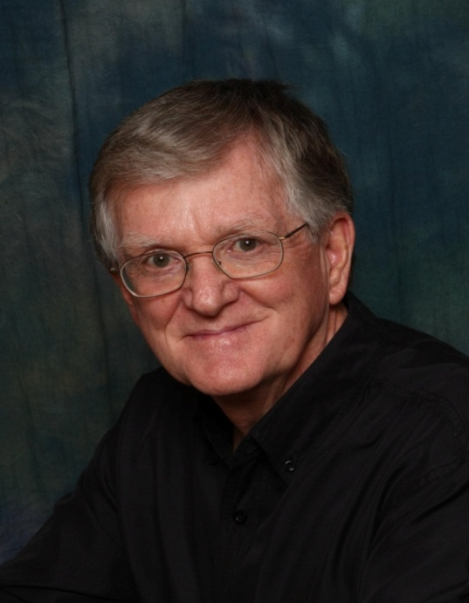
Dynamic Churches International
My name is Al Middleton and I am a co-founder and Executive Director of DCI that is presently serving in 35 countries through 200 equipped National Trainers. We have discipleship and leader development materials in 39 major languages. My wife Mary and I have 3 children, 8 grandchildren and 4 great-grandchildren. We live in Airdrie, Alberta, Canada.
This presentation was developed by Al Middleton

Slide 6
Seeing the Need
I am seeing many Churches failing to experience dramatic growth because the individual believers do not know who they are “In Christ” and so they are not living out the dynamic life that God has placed within them. The world is looking for what we have and they will be drawn to Christ when they see Him living in us!
This series of lessons will help you know who you are “In Christ!” You must choose what you will do with what you know.

Slide 7
Acknowledgments
I gratefully acknowledge that much of the teaching in this study has been adapted from the very insightful writings of Dr. Charles Solomon in his books The Handbook to Happiness and The Ins and Out of Rejection and also Brother Watchman Nee, The Normal Christian Life. I highly recommend that you purchase and read these books to gain their full teaching.
See the following websites: Dr. Solomon - ChuckGFI@aol.com
Watchman Nee - www.watchmannee.org /publications.html
Al Middleton – www.dynamicchurches.org
All Scripture quotations in this publication are from the HOLY BIBLE, NEW INTERNATIONAL VERSION. © 1973, 1978, 1984 by International Bible Society
© 2011 Dynamic Churches International All rights reserved. No part of this publication may be copied or reproduced in any form without written permission.

Slide 8

Presents
Session One
Displaying the Greatness and Glory of God
God’s Purpose in Creation

Slide 9
This Session Will Include:
An Introduction
Displaying God’s Greatness and Glory
A Preview of the Next Session

Slide 10
Thought Starters
People today have many perceptions of God.
Some see Him as:
An ancient old man – very wise, but very distant
A kind and gentle grandfatherly gentleman
A benevolent provider of all good things
A supreme and angry warlord
A stern judge who is looking for an opportunity to punish us for our misdeeds

Slide 11
Many people believe that there is no God or if He does exist then He is obsolete and irrelevant!

Slide 12
Many Christians also have a poor understanding of God

Slide 13
What is your perception of God?
How would you describe God?
On what do you base your opinion?

Slide 14
Introduction
In this study we will look at the God of the Bible and discover what it has to say about:
Displaying the Greatness and Glory of God
God’s Purpose in Creating Humanity
Love and Acceptance
How God Dealt With My Sin Nature
Being Certain of God’s Purpose for Me
Everything Changed at the Cross

Slide 15
Introduction Continued
Proclaiming What Jesus Has Accomplished for Me
Choosing to Live According to Our New Potential
The Holy Spirit
Living by the Spirit
Sharing the Gospel
Fulfilling the Great Commission
The Sunrise Strategy

Slide 16
Displaying the Greatness and Glory of God!
The following PowerPoint presentation was developed by Dan Watson showing us - through the lens of the Hubble telescope – the magnitude and wonder of the universe that God spoke into being!

Slide 17
In the beginning God created the heavens and the earth. Genesis 1:1

Slide 18
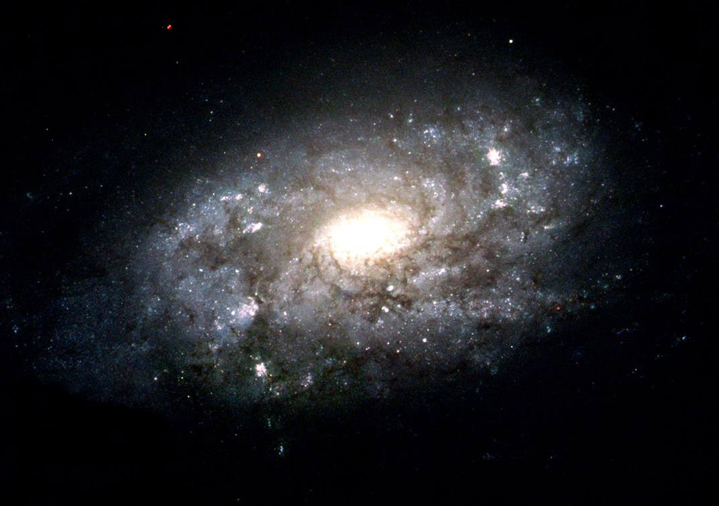

Slide 19
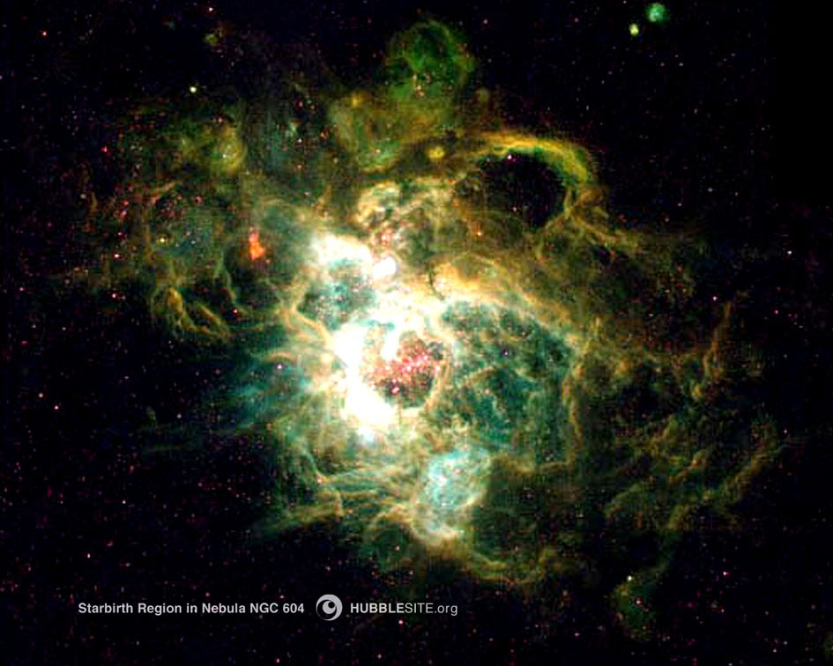

Slide 20
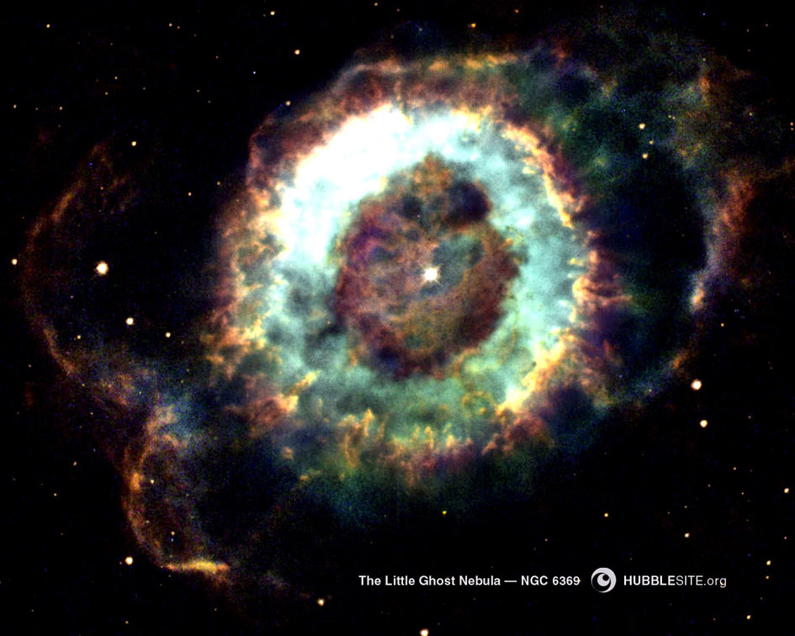

Slide 21
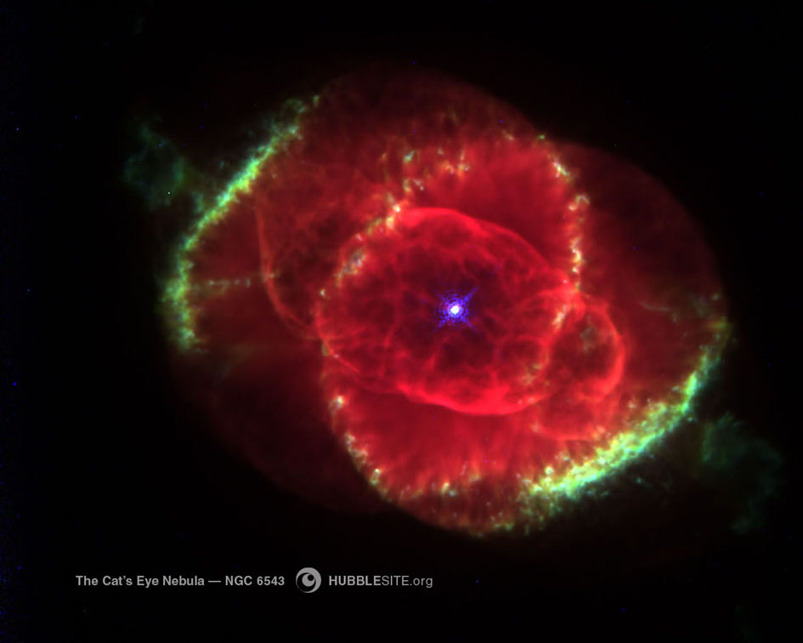

Slide 22
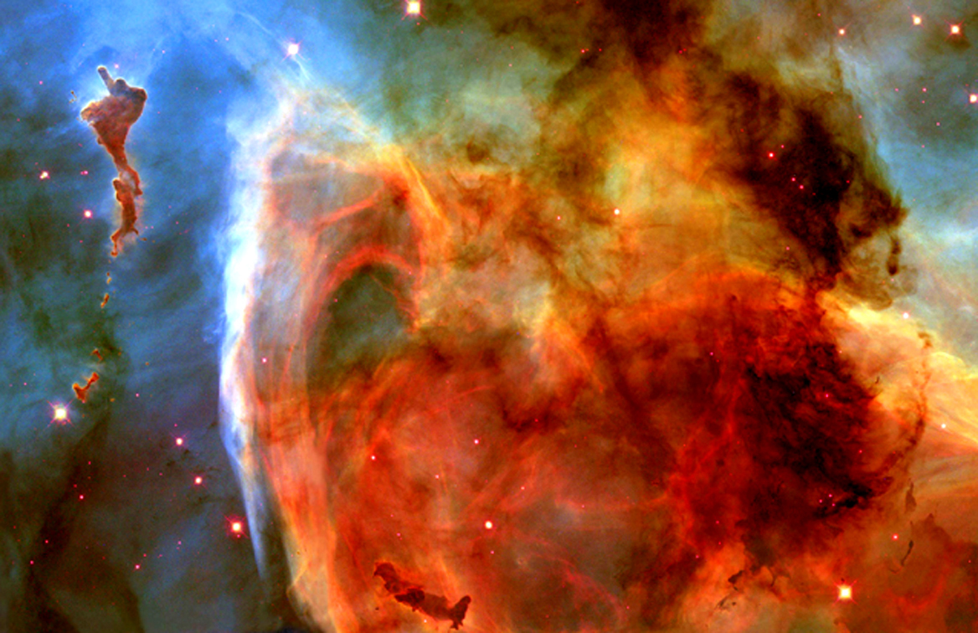

Slide 23
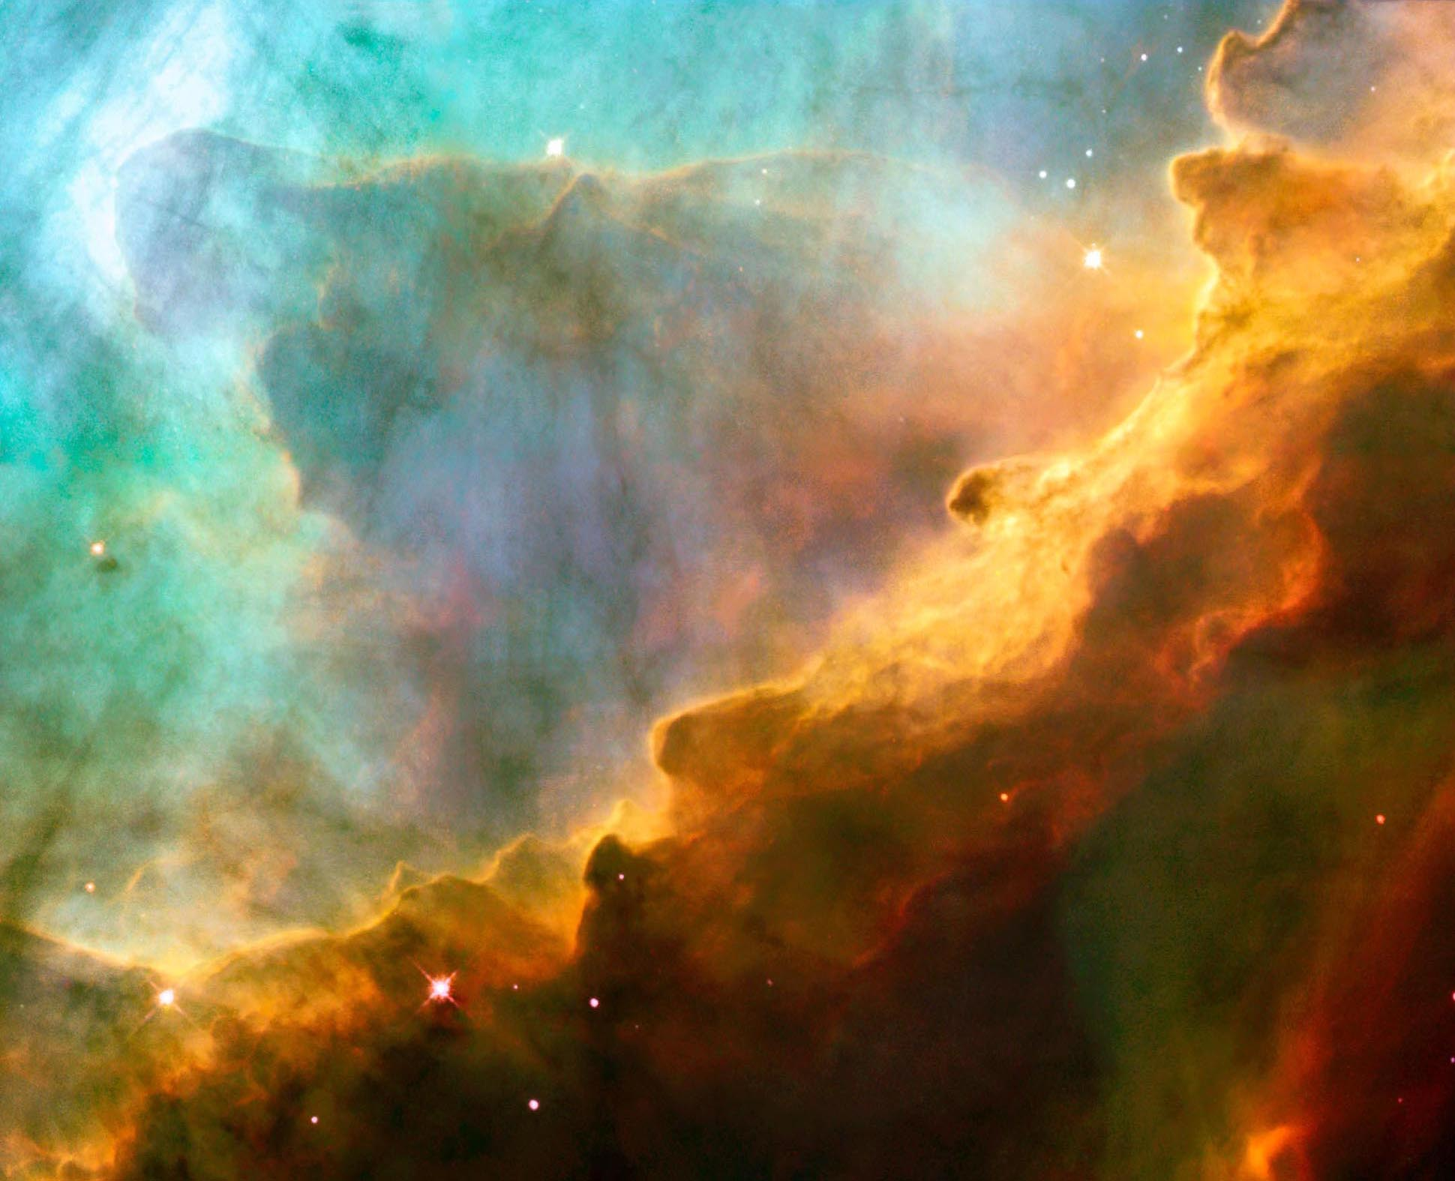

Slide 24
Thus the heavens and the earth were completed in all their vast array. Genesis 2:1

Slide 25

Our Galaxy – the Milky Way may have between 200 and 400 Billion Stars. Many of them much larger than our Sun! It would take 5,000 to 10,000 years to count them all.
Our Sun is 860,000 miles in diameter. It could contain one million earths.
It would take 100,000 light years (Travelling at the speed of light) to travel across the Milky Way!

Slide 26

Lets look closer at this empty space!

Slide 27


Slide 28

Now lets look even closer!

Slide 29
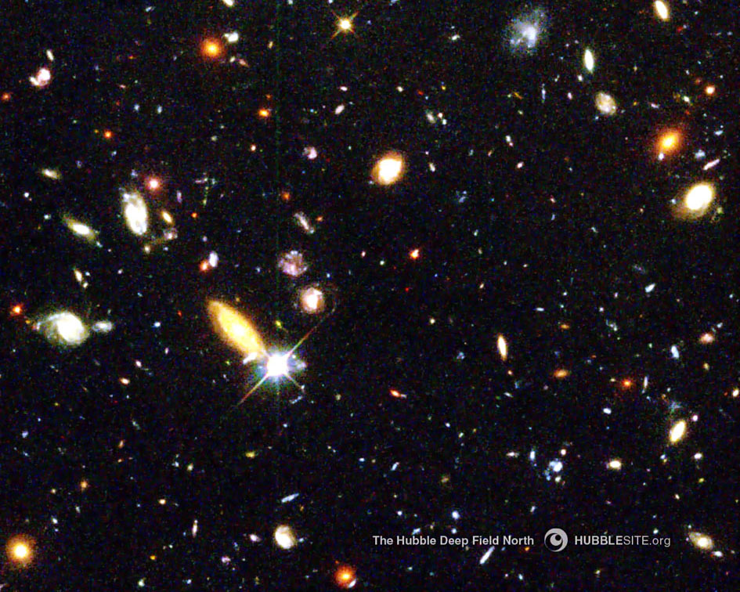
These are some of the galaxies, but this is only what we can see!
We do not know what is beyond what we can see.
It may go on for ever!

Slide 30
There may be between 100 and 200 Billion Galaxies!
That would be 12 to 24 Galaxies for each person on earth
It is estimated that there are between 10 and 70 Sextillion stars in the universe!

Slide 31
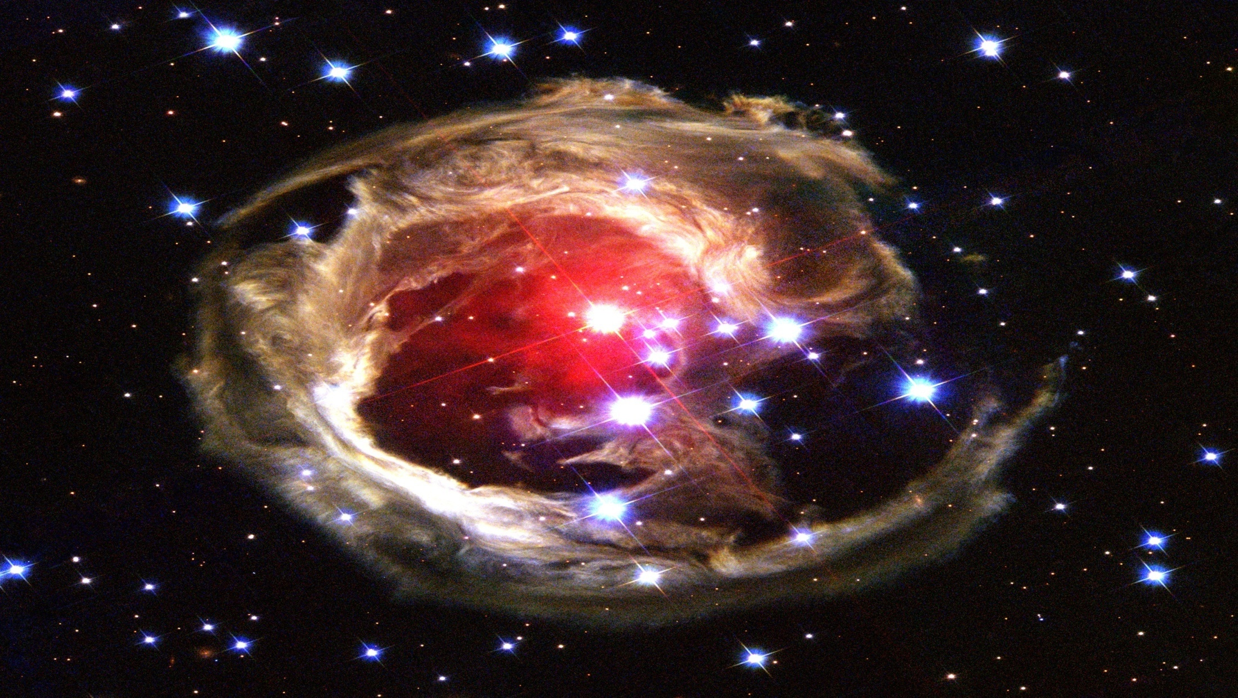

Slide 32
When I consider Your heavens, the work of Your fingers, the moon and the stars, which You have set in place, what is man that You are mindful of him...? Psalm 8:3

Slide 33
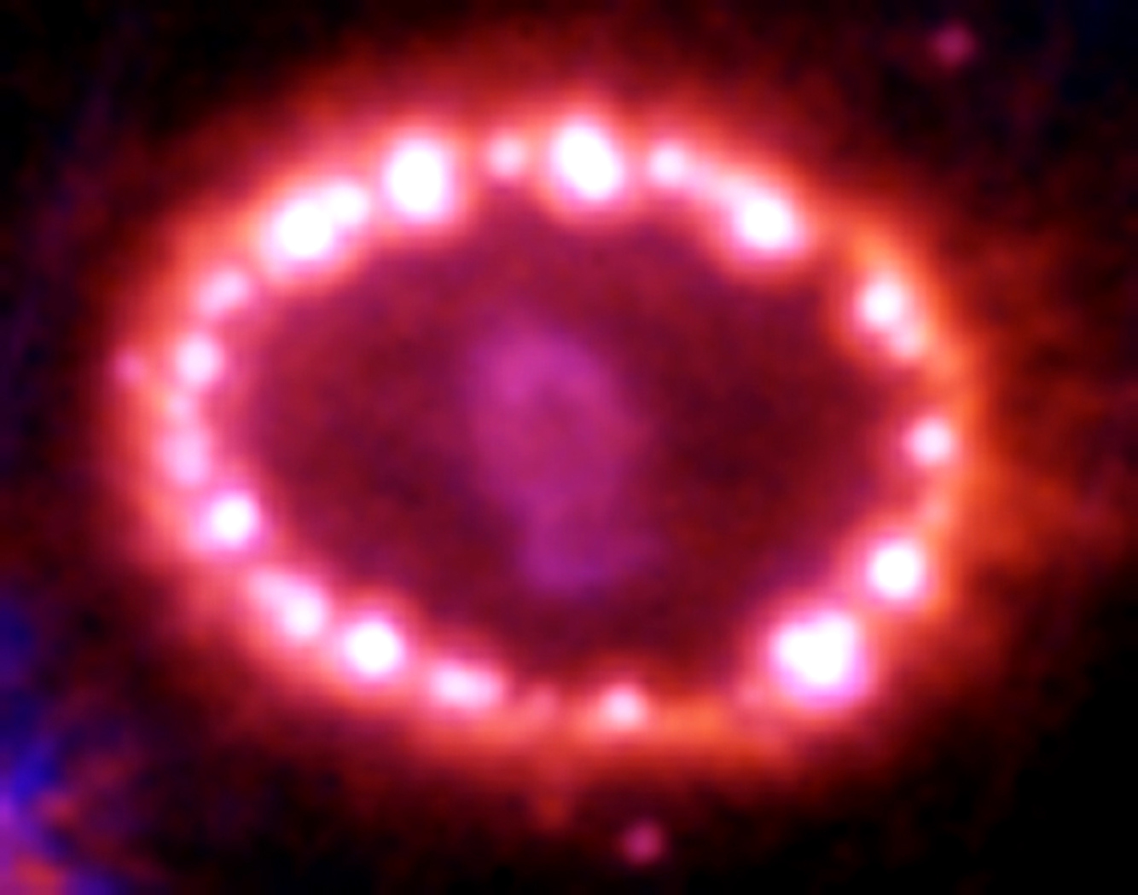

Slide 34
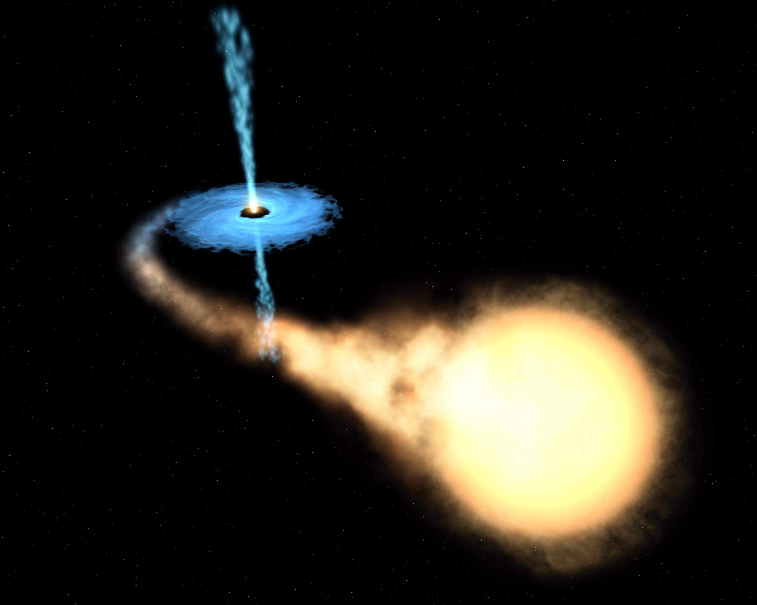

Slide 35
The Lord is exalted over all the nations, His glory above the heavens. Who is like the Lord our God, the one who sits enthroned on high, who stoops down to look on the heavens and the earth? Psalm 113:6

Slide 36
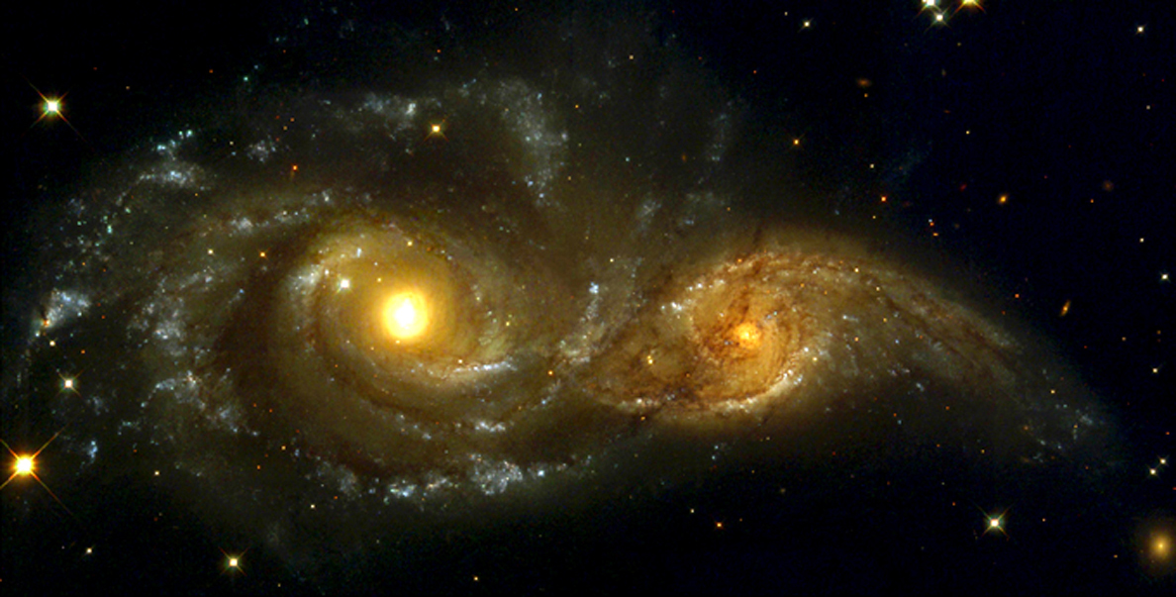

Slide 37
The heavens proclaim His righteousness, and all the peoples see His glory. Psalm 97:6

Slide 38
As the heavens are higher than the earth, so are My ways higher than your ways and My thoughts than your thoughts. Isaiah 55:9

Slide 39
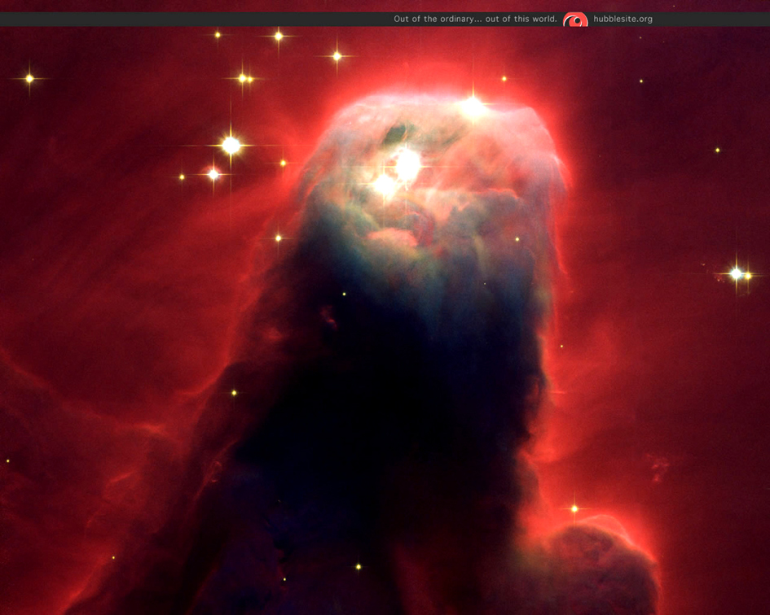

Slide 40
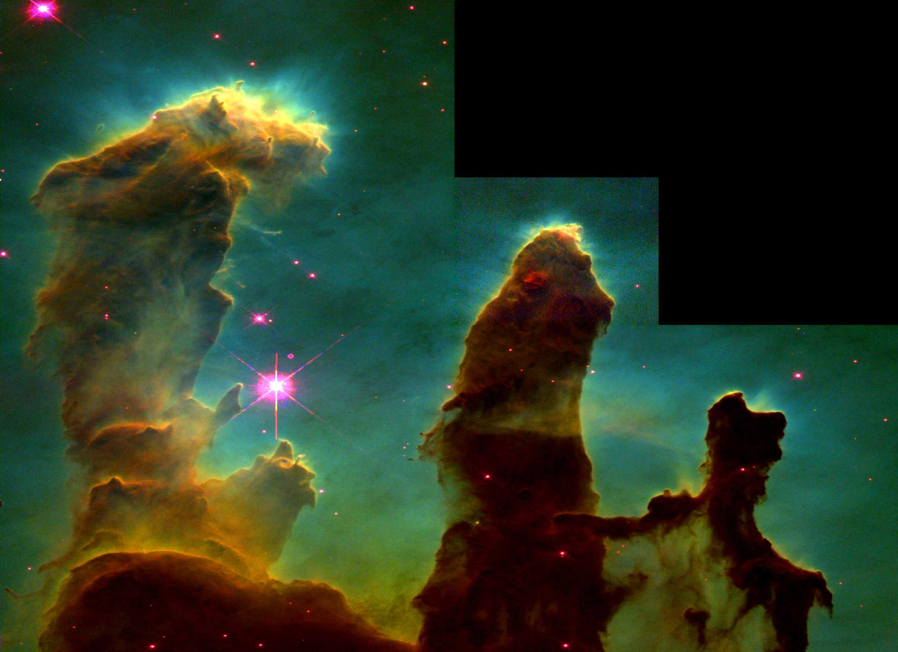

Slide 41
God is also in the Details!
Go to the internet to view this link:
  http://micro.magnet.fsu.edu/primer/java/scienceopticsu/powersof10
When we leave tonight (If the sky is clear- or the next time you are out on a clear night) – look up at the sky and spend some time marvelling at the creation that God has made and worship Him!

Slide 42
God Spoke It All Into Being
Summary:
Our own galaxy contains 200 to 400 Billion stars. Many of them are much larger than our Sun!
There may be 100 to 200 Billion Galaxies in the universe!
The immensity of the universe is beyond our ability to comprehend!
God spoke and it came into being!

Slide 43
Why Did God Create Our World?
Isaiah 43:7
“everyone who is called by my name, whom I created for my glory, whom I formed and made.”
Revelation 4:11
“You are worthy, our Lord and God, to receive glory and honour and power, for you created all things, and by your will they were created and have their being.”

Slide 44
Why Did God Create Our World?
The Father’s purpose in creating the whole universe including our world was that He wanted many sons and daughters who would live out His Divine life and fill the earth and heaven with His Glory!
Romans 8:29-30 and Revelation 5:13

Slide 45
God’s Anticipation
What anticipation the Father had that He might see the fullness of His Son in us and be satisfied!
Colossians 1:19,20; 3:9-11

Slide 46
How Great is Your God?
Discussion:
After viewing the Universe how would you describe God?
Why did God create the Universe?
Why did God create our World?
Are you experiencing God’s Ultimate Purpose in your life?
If not why not?
  Lack of Knowledge or Lack of Faith?

Slide 47
Preview of Next Session
We will see:
That God created people to fulfil His purpose.
What really happened in the Garden.
The Results of what happened in the Garden.
God’s Remedy.

Slide 48
Pray for Each Other
Choose a Prayer Partner
  You will pray for each other throughout each week
Prayer:
  Share prayer requests.
  Pray for the needs expressed.
Pray that we will each gain new insight and a new appreciation for the greatness of our God and His Ultimate Purpose.
Our Next Session
Date _______ Time _______ Place ____________

Slide 50
Presents
Session Two
God’s Purpose in Creating
Humanity
God’s Glorious Anticipation

Slide 51
Review
Displaying the Greatness and Glory of God
  This past week have you thought about how awesome God is?
  Did you get an opportunity to look up into the night sky and marvel at God’s creation?
View
God’s Purpose in creating Adam and Eve
Their sin and the Result
God’s Remedy - The Blood of Christ

Slide 52
God’s Eternal Purpose
What is God’s purpose in creation?
To display His glory (Eternal Character).
To display His glory through His children.
Isaiah 43:7
“Everyone who is called by my name, whom I created for my glory, whom I formed and made.”

Slide 53
The result of sin was not so much that they would be punished, but that they would miss the opportunity to enjoy the glory of His life.
In Romans 3:23 we read:
“all have sinned and fall short of the glory of God”.

Slide 54
Perspective of Sin
What is God’s purpose in redemption?
God wants us to live out of His very life and He offered that opportunity to Adam, but what breaks the heart of God is that Adam chose to live independent from God and missed out on the glory (Character) of God.
The result of sin is that we forfeit God’s glory - the result of redemption is that we are now qualified to enjoy His glory.

Slide 55
Two Realms/Two Realities
God is Eternal and His realm is not limited in any way!
He is Eternally Present! Always was! Always will be!
We are temporal and are limited by time and space.
In this session we will try to relate the eternal to the temporal realities.

Slide 56
God’s Purpose - Eternal Life/Glory
Eternity Future Heaven
Eternity Past
Christ’s Life = Eternal Life
Eternity Present
“Eternal Life” is more than just a long life; it is a whole new life - the type of life that God has, with no limitations of any kind.
Jesus prayed to His Father:
“ Now this is Eternal life: That they may know You, the only true God, and Jesus Christ, whom You have sent.” John 17:3
“I am the Alpha and the Omega,” says the Lord God, “who is, and who was, and who is to come, the Almighty.” Revelation 1:8

Slide 57
God’s Purpose - Eternal Life/Glory
Eternity Future Heaven
Eternity Past
Christ’s Life = Eternal Life
Eternity Present
Eternal Life means Eternally Present
God’s name is:
“I AM”

Slide 58
God’s Eternal Purpose…
Was to have children who live in total dependence on Him and display the same nature and glory of His life and character.
Was for Adam to live out of the very life of God – to enjoy God’s eternal life in his own reality and to reproduce generations of mature godly sons and daughters who would fill the earth with God’s Glory

Slide 59
God’s Eternal Purpose…
Jesus was and is God and is uniquely the only begotten Son of God the Father, but the Father had only one Son and He had a deep desire that Jesus would be the first born of many sons and daughters. Jesus also desired to have many brothers and sisters!

Slide 60
God’s Eternal Purpose…
“In bringing many sons to glory, it was fitting that God, for whom and through whom everything exists, should make the author of their salvation perfect through suffering. Both the one who makes men holy and those who are made holy are of the same family. So Jesus is not ashamed to call them brothers.” Hebrews 2:10,11

Slide 61
God’s Anticipation
What glorious anticipation that the Father might see the fullness of His Son in us and be satisfied.

Slide 62
God Offered Adam Eternal Life
Adam Chose Independence from God
Tree of Life = Dependence on God
Eternity Future Heaven
Eternity Past
Christ’s Life = Eternal Life
Eternity Present
Our only option was separation from God forever =
Adam Died = You are Dead to God
Tree of the Knowledge of Good and Evil = Independence
Separated From God
Adam was created neutral neither Holy nor Sinful
Hell
If your father died before he had any children – how would that have affected your life? You would have died physically in your father! Likewise you died spiritually in Adam. When he sinned you sinned – when he died you died!
“Therefore, just as sin entered the world through one man, and death through sin, and in this way death came to all men, because all sinned …” Romans 5:12

Slide 63
God Offers to Forgive Our Sins
Eternity Future Heaven
Eternity Past
Christ’s Life = Eternal Life
Eternity Present
Adam Died = You are Dead to God
Separated From God
Hell
Because I am born of Adam: I am a sinner by nature, therefore, I commit acts of sin. You see - I am not a sinner because I sin, no - I sin because I am a sinner
“for all have sinned and fall short of the glory of God,… God presented Him (Jesus) as a sacrifice of atonement, through faith in His blood.” Romans 3:23, 25

Slide 64
God Offers to Forgive Our Sins
Eternity Future Heaven
Eternity Past
Christ’s Life = Eternal Life
Eternity Present
Adam Died = You are Dead to God
Separated From God
Hell
“But God demonstrates His own love for us in this: While we were still sinners, Christ died for us.” Romans 5:8
“For the wages of sin is death, but the gift of God is eternal life in Christ Jesus our Lord.” Romans 6:23

Slide 65
Paul says to Timothy that the Father,”has saved us and called us to a holy life - not because of anything we have done but because of His own purpose and grace. This grace was given us IN CHRIST JESUS BEFORE THE BEGINNING OF TIME, but it has now been revealed through the Lord Jesus Christ..” 2 Timothy 1:9-10
It was God’s plan from before the world was made to redeem us and call us to be His children!

Slide 66
God Offers to Forgive Our Sins
Christ died for my Sins
Eternity Future Heaven
Eternity Past
Christ’s Life = Eternal Life
Eternity Present
Adam Died = You are Dead to God
Separated From God
Hell
“Christ died for sins once for all, the righteous for the unrighteous, to bring us to God.” 1 Peter 3:18
“..to all who receive Him, to those who believe in His name, He gave the right to become children of God…” John 1:12

Slide 67
God Offers Forgiveness of Our Sins
Christ died for my Sins
God offers me Eternal Life
Eternity Future Heaven
Eternity Past
Christ’s Life = Eternal Life
Eternity Present
I must receive Christ
Adam Died = You are Dead to God
Separated From God
Hell
If so pray this prayer: Lord Jesus, I have sinned against You by living independent from You. Thank You that You died for my sins. I invite You to live Your Eternal Life in me. Amen
Do you want to receive Christ and have your sins forgiven and have Eternal Life?

Slide 68
Did You Receive God’s Offers?
Christ died for my Sins
Eternity Future Heaven
Eternity Past
Christ’s Life = Eternal Life
Eternity Present
Adam Died = You are Dead to God
Separated From God
Hell
Do you know Christ died for your sins?
Did you receive His gift of forgiveness?
Do you know you have Eternal Life?

Slide 69
Questions
Now that you know that your sins are forgiven, are you now capable of living the Christian life?
Does being forgiven mean that you will never sin again?
Can I repair my old life to make it acceptable to God? (See 2 Corinthians 5:17)

Slide 70
Application Project
Try to consciously thank Jesus each day this week that He died for your sins.
Do not ask God to forgive you, but thank God that you are forgiven!
Tell a friend or family member that you are forgiven and that you have eternal life.

Slide 71
Preview of Next Session
In our next session we will see that our world has programmed us to be acceptable based on our performance and rejects us when we fail.
We will see that we are accepted by God and that we have a new past and a whole new beginning!
Praise God!

Slide 72
Pray for Each Other
Prayer:
  Share prayer requests.
  Pray for the needs expressed.
Pray that we will each clearly understand that Jesus Christ died for my sins and that by receiving what Jesus accomplished for me I am forgiven.
Our Next Session
Date ______ Time ______ Place ___________

Slide 74
Presents
Session Three
Love and Acceptance
Our Greatest Need

Slide 75
Application from Last Session
Did you consciously thank Jesus each day this past week that He died for your sins?
Remember that you do not need to ask God to forgive you, but thank Him that you are forgiven because of Christ’s death on the cross!
How has knowing that fact helped you this week?
Did you tell a friend or family member that you are forgiven and that you have eternal life?
Share your experience with us.

Slide 76
Love and Acceptance:
Thought Starters
Describe a time when you felt most affirmed as a person.
Why was it a good experience for you?

Slide 77
Our Greatest Need
They say that our greatest need is to love and to be loved.
Why do you think this is true?
What other human has shown you the most love and acceptance?
What was the basis for that love and acceptance?
We are programmed from early childhood that acceptance is based on our performance.

Slide 78
Rejection
To be rejected is a very damaging response from people especially those you look up to!
Why is that true?
We have all experienced rejection in our lives.

Slide 79
Rejection Takes Many Forms
In his excellent books, “The Ins and Out of Rejection” and “The Handbook to Happiness” Dr. Charles Solomon suggests that rejection manifests itself in many ways, but they could be listed in two categories:
  Overt (open and obvious rejection) and
  Covert (Subtle rejection) – you may hear “I love you”, but you may sense that you are not loved.

Slide 80
Overt Rejection
You know you have been rejected when your mother or father says,
  “I wish you had never been born!”, or
  “You will never amount to anything!” or
  “Why can’t you be more like your brother?”
  You could develop feelings of being unwanted, unloved and worthless! (Worth less than….)
  Feeling unworthy you often will reject yourself.
  With Overt Rejection you will probably have some understanding of why you behave as you do.

Slide 81
Covert Rejection
You and those who are rejecting you may not even be aware that there is any rejection and so it can create great confusion and often great guilt because you hear them say that they love you but you don’t feel loved so you tend to blame yourself as being the problem. Symptoms could include:
  Over-protection
  Over-indulgence

Slide 82
Covert Rejection
  Over-protection – Not letting you do anything, saying in effect that you are incapable, inadequate or inferior and cannot do it yourself. or
  Over-indulgence – Giving you everything you want and not allowing you to mature as a person by making your own mistakes and finding your own way.

Slide 83
Rejection in the World
The world accepts the beautiful and the talented people!
Those people are often envied and/or resented by the rest of us who try to measure up but fail to compete.
At home, at school, on the job and in society we are rewarded for excellent behaviour and rejected or demoted based on our inadequate performance.

Slide 84
Rejection in the Church
The Church should be the center of love and acceptance, but often it too is an environment of rejection.
When we become a believer we have already been programmed by the world that acceptance is based on our performance.
This attitude carries over into the church.
We need to be taught that we are one in Christ and acceptable to God and each other for who we are not for what we do!

Slide 85
How Has the Church Rejected?
Many Pastors preach that we should:
  Pray more - Read our Bibles more
  Give more - Serve more and Witness more
While these are all good things to do, one soon gets the impression that to fail to do them is to fail and to disappoint the Pastor and the other leaders in the Church – even God – rejected!
Trying to be accepted, you either redouble your effort or you give-up trying and as a result many have dropped out of the Church.

Slide 86
What is the Cure for Rejection?
We need to understand that we cannot make ourselves acceptable to God or even to other people.
We need to understand that as a Christian we are already acceptable to God because of what Jesus has done.
How has He demonstrated that He loves and accepts us? “While we were yet sinners – Christ died for us.” Romans 5:8

Slide 87
What is the Cure for Rejection?
Our perspective is:
If you perform as I expect = Acceptance
If you do not perform as I expect = Rejection
Jesus had every reason to reject us based on our performance!

Slide 88
John 3:16, “For God so loved the world that He gave His one and only Son, that whoever believes in Him shall not perish but have eternal life.”
God the father sent His Son and Jesus willingly came to die for you!
“…neither height nor depth, nor anything else in all creation, will be able to separate us from the love of God that is in Christ Jesus our Lord.” Romans 8:38-39
God loves you and accepts you completely!
He is King of the universe – You cannot be loved and accepted by anyone higher!
How did He show His love for us?

Slide 89
Two Sides of the Cross
Jesus shed His Blood for the forgiveness of our sins!
Jesus gave His life so that we could live!
We receive His life and live to the glory of God with Jesus as our life!
We receive forgiveness
“For if while we were enemies we were reconciled to God through the death of His Son, much more, having been reconciled, we shall be saved by His life.” Romans 5:10

Slide 90
The Passover – Two Purposes
The lamb was slain and it’s blood put on the doorposts so the death angel would pass over their house = Salvation
The lamb was eaten by them to give them life and strength for their journey = Walk

Slide 91
Communion – Remembering Him
We take the wine to remember His Blood that He shed to forgive our sins
We take the bread into us to remember His Body (Life) was given to us as life and strength for our journey
Jesus says in John 6, “I am the bread of life…Unless you eat the flesh of the Son of Man and drink His blood, you have no life in yourselves. He who eats My flesh and drinks My blood has eternal life.”

Slide 92
Jesus is Our Life
Jesus says, “I am the bread of life… our Lord Jesus Christ is life.
We don’t receive God the Father, but we can receive the Lord Jesus. The fruit is the edible part, the receivable part of the tree. So - may I say it reverently? - the Lord Jesus is really God in a receivable form.
God in Christ we can receive as our life.

Slide 93
Common Path of Teaching to Achieve Acceptance in the Church
9. Service (Leading souls to Christ)
8. Fellowship (Church Membership)
7. Confession of Sins (1 John 1:9)
6. Doubts (Satan)
5. Security (Joy)
4. Assurance of Salvation
3. Lordship (Romans 12:1)
2. Saved from Sin
1. Conviction of Sin (Sinner)
Christ’s Death for our sins
The Blood of Christ for our forgiveness is only half of the Gospel

Slide 94
Continued Path of Teaching to Achieve Freedom In Christ!
9. Service (Leading Christians to the Cross)
8. Fellowship (With Spirit controlled Believers)
7. Victory Over Self or Flesh
6. Doubts (Satan)
5. Security (Victory)
4. Assurance of Our Identification
3. Obedience to Christ-Life within
2. Saved from Self
1. Conviction of Self (Flesh “Selfer”)
The Cross of Christ to give us His life is the other half of the Gospel
Our Death In Christ

Slide 95
Understanding the Cross of Christ
We will know real freedom from rejection and we will grow in the Christian life when we understand that Christ demonstrated that we are fully accepted by what He accomplished on the Cross.
When you received Christ as your Saviour, what did you understand of what God accomplished when Christ died on the cross? Discussion.

Slide 96
Application Project
Consciously thank God each day this week that you are totally loved and completely accepted by Him.
Watch for indications that you lived differently this week because you know that you are loved and accepted by God, and come next time prepared to share your experiences.

Slide 97
Preview of Next Session
In our next session we will see that our old self (sin nature/spirit that was dead to God) did not need repair – it was too bad for that - no it needed to die and be raised as a new creation to become One with the Holy Spirit giving us a whole new nature!
This too Jesus has accomplished!
Praise God!

Slide 98
Pray for Each Other
Prayer:
  Share prayer requests.
  Pray for the needs expressed.
Pray that we will each clearly understand that Jesus Christ demonstrated His total love and acceptance of us when He died on the cross.
Our Next Session
Date ______ Time ______ Place ___________

Slide 100
Presents
Session Four
How God Dealt with
My Sin Nature
The Cross of Christ

Slide 101
Application from Last Session
Did you thank God each day this past week that you are totally loved and completely accepted by Him?
Give an example of how you lived differently this past week because you know that you are loved and accepted by God. Share your experiences.

Slide 102
Review Discussion Questions
If someone sins is he/she a sinner?
What if they did not sin would they be a sinner? Why?
Romans 5:19 What were we by nature?
How did we become what we were?
What could I have done to improve my behaviour or my circumstance?
As a sinner could I ever fulfill God’s purpose to Glorify Him by displaying His Glory?

Slide 103

Who Are We?
We are a Spirit who has a Soul or Personality and we live in a Body!
Our Body and Soul are not who we are.
We are Spiritual beings!
Body
Soul
Spirit

Slide 104
What Died?
God told Adam, “you must not eat from the tree of the knowledge of good and evil, for when you eat of it you will surely die.” Gen. 2:17
Adam and Eve ate in disobedience to God and they died! Did they die in their:
  Body? Adam lived 930 years.
  Soul (Personality)? They still had a personality.
  Spirit? Their Spirit became dead to God, but remained alive to Satan and to this world.

Slide 105
Good and Evil
The issue is not Good or Evil, for they are both a display in our Soul and Body of our dead Spirit that is operating independently from God!
The real issue is, do we have a Spirit that is alive to God and dependent on Him as our life or a Spirit that is trying to produce life through our own initiative (Developing our Soul and Body to be the best they can be) in independence from the life of God!

Slide 106
In Adam
Read Romans 5:12 to 21 (see verse 19)
In Adam we received everything that is of Adam;
We were born of Adam and in his family line with his nature - the nature of a sinner.
How do we get out of Adam’s family line?
Since we came in by birth we must go out by death!
How?

Slide 107
I am Dead to Sin
Christ died for my Sins
When I receive Christ the Father places me in His Son! I am now identified with Jesus!
I am a Partaker of His Divine Nature
And I died with Christ
I Died to Adam’s Life
I am Alive to God
Eternity Past
Christ’s Life = Eternal Life
Eternity Future Heaven
Eternity Present
Buried
Adam Died = You are Dead to God
But because I was Born into Adam’s Life
Separated From God
Hell
I needed to die to Adam’s Life
Lord Jesus, I have sinned against You by living independent from You. Thank You that You died for my sins and that I died with You. I invite You to live Your Eternal Life in me. Amen
“I have been Crucified With Christ and I no longer live, but Christ lives in me.” Galatians 2:20
Have you claimed by faith that Christ is now your life?

Slide 108
Discussion Questions
Do you know your sins are forgiven?
Do you know that when Christ died that you died with Him?
In His death did He include you?
In His resurrection did He include you?

Slide 109
Discussion Questions
Are you in Christ Jesus?
In Christ we received everything that is of Christ.
Are you experiencing His Eternal Life as your life?
Is Jesus free from sin?
Are you free from sin?

Slide 110
Because I Am In Christ:
I am a New Creation - 2 Cor. 5:17
I am free from sin’s power – Rom. 6:,7,22
I have Christ’s Righteousness – 2 Cor. 5:21
I am alive to God – Rom. 6:11
I am indwelt by the Holy Spirit – Rom. 8:9
I am a partaker of His Divine Nature 2 Peter 1:4
I am one with Jesus and the Father - John 17:21-23

Slide 111
Jesus said:
After Jesus was raised from the dead He said, “…to your Father and My father …to your God and My God”. John 20:17
Jesus also said, “I am not ashamed to call them My brothers”. Hebrews 2:11, 12
We are children of God!
We are one with each other
We are one with Jesus and the Father

Slide 112
What Does “Being One” Mean?
In John 17:20-23, Jesus is praying to the Father for all those who would be His followers. He said, “I pray… that all of them may be one, Father, just as you are in me and I am in you. May they also be in us so that the world may believe that you have sent me. I have given them the glory that you gave me, that they may be one as we are one: I in them and you in me. May they be brought to complete unity to let the world know that you sent me and have loved them even as you have loved me.”

Slide 113
Examples: Oneness in Marriage
God gave each person wonderful and distinctly different personalities
Sunny/Happy Rainy/Serious
All sunshine and no rain will produce a desert
All rain and no sunshine will produce a swamp

Slide 114
Oneness in Marriage
When God puts us together….

Slide 115
Oneness in Marriage
…. as One we contain both Rain and Sunshine, but we Become something brand new and
much greater than the individual parts
- Producing a beautiful Garden!

Slide 116
Oneness in the Church
Jesus says,“we are the body of Christ”.
One as Jesus and the Father are One!
“that they may be one as we are one”.
How did we become one?
When did we become one?

Slide 117
Oneness With Each Other and With God
Two Rivers Come Together
When did they become One River?
Will the Rivers ever again not be One?
When do we become One in Relationships with each other and with God?
Will we ever again not be One?
X
Maturity is not about becoming One, but Experiencing the Oneness that we already have In Christ Jesus!

Slide 118
Jesus Came to Us!
“In your relationships with one another, have the same mindset as Christ Jesus: Who, being in very nature God, did not consider equality with God something to be used to his own advantage; rather, he made himself nothing by taking the very nature of a servant, being made in human likeness. And being found in appearance as a man, he humbled himself by becoming obedient to death - even death on a cross!” Philippians 2:5-8

Slide 119
One With Jesus and the Father
Jesus willingly left the glories of heaven!
He gave up all that He was and had to be one with us!
So that we could give up all that we are and have to be one with Him!
So that we could enter into the glory He had with the Father!

Slide 120
Our Sin for His Righteousness!!
“God made Him who had no sin to be sin for us, so that in Him we might become the righteousness of God”. 2 Corinthians 5:21

Slide 121
Review Discussion Questions
What does it mean to you personally to be:
Free from your old sin nature?
A new creation and have a new nature?
The Righteousness of God?
A Partaker of God’s Divine Nature?
One with each other (His Church), with Christ and with the Father?

Slide 122
Application Project
Thank God each day this week that:
  You are a new creation in Christ,
  You are no longer a sinner by nature, but,
  You are the righteousness of God in Christ Jesus!
Live Differently!

Slide 123
Pray for Each Other
Prayer:
  Share prayer requests.
  Pray for the needs expressed.
Pray that we will no longer let sin control us as it used to control our old nature, but that we would each live out of the new nature (Christ’s life) we now have because we died and rose again with Jesus Christ.
Our Next Session
Date _______ Time _______ Place _____________

Slide 125
Much of this session is adapted from the teaching of Watchman Nee from his book, The Normal Christian Life.
Presents
Session Five
Being Certain of God’s Purpose for Me
Certainty Moves Us Forward

Slide 126
Application from Last Session
Did you thank God each day this past week that:
  You are a new creation in Christ,
  You are no longer a sinner by nature, but,
  You are the righteousness of God in Christ Jesus?
How did you Live Differently?

Slide 127
Preview
The Vibrant Christian Life begins with a very definite “Knowing”!
More than just intellectual knowledge.
God must reveal it to our hearts to be able to see what we have in Christ.
This session will help us see why we can “know” that we are dead to sin and alive to God!

Slide 128
Knowing – Read Romans 6:1-11
My Death with Christ is Historical Fact
He did not just die for the sins of the world – He died for my sins on the cross!
I must also see Myself being put into Christ by God the Father
2 Corinthians 4:18 says; “So we fix our eyes not on what is seen, but on what is unseen. For what is seen is temporary, but what is unseen is eternal.”

Slide 129
How Did You Receive Forgiveness?
Did you ask Jesus to die for your sins?
Did you realize that Jesus died personally for your sins?
Did you thank Him that He has already died for your sins?
Do you know that your sins are forgiven?
How do you know?

Slide 130
I am Dead to Sin
Christ died for my Sins
When I receive Christ the Father places me in His Son! I am now identified with Jesus!
And I died with Christ
I Died to Adam’s Life
Eternity Past
Christ’s Life = Eternal Life
Eternity Future Heaven
Eternity Present
Adam Died = You are Dead to God
But because I was Born into Adam’s Life
Separated From God
Hell
I needed to die to Adam’s Life
“I have been Crucified With Christ and I no longer live, but Christ lives in me.” Galatians 2:20

Slide 131
How Do You Overcome Your Sinful Behaviour?
By your self will (will power)?
Do you try to suppress your bad behaviour?
Do you beg God for more power?
Do you ask God to make you stronger?

Slide 132
How Does God Overcome Your Sinful Behaviour?
We are a sin producing factory – God does not just take care of the sin but the factory!
God has set us free from sin by crucifying our old sin nature on the cross with Jesus Christ.
God destroyed (made inoperative) our old sin nature!
Praise God!!

Slide 133
Your Deliverance Has Already Been Provided As Well! Praise God!
If you have received Christ then God has put you in Christ so that when Christ was crucified you were also crucified.
Do you need to pray, “Lord, I am a very bad person; please crucify me”? _____
Why?

Slide 134
Important Questions
Romans 5:8 says, “Christ died for us while we were sinners”. Is that true?
Romans 6:6 says, “Our old self (Dead Spirit – dead to God, but alive to Satan and this world) was crucified with Him”. Is that true?
Romans 6:8 says, “We died with Him”.
Is that true?
When did we die? –Yesterday? Today? Tomorrow? Or when Christ died?

Slide 135
How Do You Know?
Is your knowledge of being crucified based on:
Your feelings?
Is it because the Bible says it is so?
Do you see it because the Holy Spirit has revealed it to you?
  Read Matthew 16:13-17

Slide 136
Discussion Questions
Romans 6:6 “For we know that our old self was crucified with Him so that the body of sin might be done away with, that we should no longer be slaves to sin…”
What follows in Romans 6:11?
How can we Know we are dead to sin?
Do you know? Read 1 Peter 3:18

Slide 137
Discussion Questions
How did God deal with our sins?
- Christ shed His blood for them.
How does God deal with our sin nature within us? - He removes us the sinner!
We can consider our crucifixion with Christ as fact because it was accomplished in the past. It is history!
God must reveal to you that it has been done before you can accept it by faith.

Slide 138
Example:
A Sunday school teacher asked a student to define faith. He said, “faith is believing something is true even when it is not true”.
No! Faith is believing something is true because it is true! We can “reckon” (consider as fact) that we are crucified with Christ because it is a fact of history. Considering it as fact does not make it so – no, we consider it to be so because it is so!

Slide 139
Applying these truths in our daily reality
What if I fall to old desires and sin?
Does that change the fact of my crucifixion in the past with Christ?
Satan’s main objective is to get us to doubt what God has said.
We often believe what seems to be true – by our natural senses, instead of what God has said to be true.
Trust God and ignore your feelings.

Slide 140
Paul said in Romans 6:11, “count yourselves dead to sin, but alive to God in Christ Jesus.” How is it possible? In Christ Jesus! It does not depend on you to make it so. It is only because you are in Christ Jesus.
Is Jesus dead to sin? Where are you?
Do not look to your actions or behaviour. Your faith should not be in you at all but in Christ.
It is always and only true in Christ!
And you are in Christ!

Slide 141
Read Romans 6:3-11.
To be baptised means to be totally identified with Christ.
(v.3) When Christ died
I died with Him
(v.4) When Christ was buried,
I was buried with Him
(v.4,5) When Christ was raised to new life in the resurrection
I too was raised to walk in newness of Life
(v.6) Knowing that my Old Self was crucified with Christ,
I am no longer a slave to sin
(v.7) Because I died,
I am now free from sin
(v.11) I must now consider as fact that
I am dead to sin but alive to God in Christ Jesus
It all happened when I died with Christ on the Cross!

Slide 142
Paul said, “Faith is the Substance (or substantiating) of things hoped for”.
Example: Colours (red, yellow, green etc.) are real, but if I close my eyes then to me the colours are no longer real. When I open my eyes and see them they become real in my experience. I substantiate that they are real.
Facts are facts whether we see them or not – they become true in my experience when God opens my eyes to see what He sees – to believe what He has said to be true!

Slide 143
Application Project
If you are certain that you have died with Christ and that He is now your life, then share that fact with a friend or family member.
If you are not certain that you have died with Christ and that He is now your life, then tell God you want to know, and ask the Holy Spirit to show you.

Slide 144
Preview:
In our next session we will see that everything was changed at the cross.
Not only for you and me, but all of history changed because of what Jesus did on the cross.

Slide 145
Pray for Each Other
Prayer:
  Share prayer requests.
  Pray for the needs expressed.
Pray that we will each live a victorious life because we know with the certainty that only the Holy Spirit can give that we are a new creation through what was accomplished for us all by Jesus Christ.
Our Next Session
Date ______ Time ______ Place ___________

Slide 147
Presents
Session Six
Everything Changed
at the Cross
The Cross Divides History

Slide 148
Application from Last Session
Did you share with a friend or family member that you are certain that you have died with Christ and that He is now your life?
If you were not certain that you have died with Christ and that He is now your life, then did you tell God you want to know, and ask the Holy Spirit to show you?
Share your experiences with us.

Slide 149
The Cross Divides History
Our old history ended with the Cross - we now have a New Past
Our new history began with the Resurrection - we now have a New Present and a New Future
“if anyone is in Christ, he is a new creation; the old has gone, the new has come!” 2 Corinthians 5:17

Slide 150
Old and New Covenants
God made a covenant with the children of Israel through Moses at mount Sinai
The night before He was crucified, Jesus said, “..this cup is the new covenant in my blood;…”
1 Corinthians 11:25
“if anyone is in Christ, he is a new creation; the old has gone, the new has come!” 2 Corinthians 5:17

Slide 151
Old Commandments of God
The 10 Commandments
Keep the law and you will be blessed
Disobey the law and you will be punished
“The Lord commanded us to obey all these decrees and to fear the Lord our God, so that we might always prosper and be kept alive,…” Deut. 6:24
Jesus summarized the Law and the Prophets by saying: “Love the Lord your God with all your heart, with all your soul, with all your mind and with all your strength, and love your neighbour as yourself. Matt. 22:37-39

Slide 152
Forgiveness/Righteousness Obtained
The Old Way Sacrifices for sin day after day
“When Moses had proclaimed every commandment of the law to all the people, he took the blood of calves, … and sprinkled the scroll and all the people.” Heb. 9:19
The New Way Christ’s Sacrifice for sin once and for all
“…we have been made holy through the sacrifice of the body of Jesus Christ once for all.” Heb. 10:10
“In fact, the law requires that nearly everything be cleansed with blood, and without the shedding of blood there is no forgiveness. Heb. 9:22

Slide 153
New Commandment of God
God’s Command
“And this is His (the Father’s) command: to believe in the name of His Son, Jesus Christ, and to love one another as He (Jesus) commanded us. 1 John 3:23
Jesus taught us many things, but He only Commanded us to do One Thing!
Jesus’ Command “A new command I give you: Love one another. As I have loved you, so you must love one another. By this all men will know that you are my disciples, if you love one another.” John 13:34-35

Slide 154
Two Kingdoms
The following is adapted from the teaching of Watchman Nee from his book, The Normal Christian Life.
The kingdom we see today in our temporal world is not the kingdom of God. God has a plan for the world and the universe as He created it to be - one headed up by Jesus Christ His Son. See Col. 1:16,17
But Satan, working through our flesh, has set up a rival system known in Scripture as “this world” - a system in which we are involved, as it is all around us, one which Satan dominates. He has become “the prince of this world.” John 12:31

Slide 155
Two Creations
Because of Satan, the first creation has become the old creation.
God has no desire to develop the old creation.
He is bringing in a new creation, a new kingdom and a new world, and nothing of the old creation, the old kingdom or the old world can be brought into the new creation.

Slide 156
One or the Other
“He has rescued us from the dominion of darkness and brought us into the kingdom of the Son He loves.” Colossians 1:13
“Flesh gives birth to flesh, but the Spirit gives birth to spirit.” John 3:6
“.. flesh and blood cannot inherit the kingdom of God, nor does the perishable inherit the imperishable.” 1 Corinthians 15:50

Slide 157
One or the Other
Your qualifying for the new kingdom is determined by the creation to which you belong. Do you belong to the old creation or the new?
The question is not ‘good’ or bad?’ but ‘flesh or Spirit?’ “That which is born of the flesh is flesh”, and it will never be anything other than flesh.
Are you born of the flesh or of the Spirit?
Nothing of the old creation can ever pass over into the new.

Slide 158
Salvation
What is salvation?
From what are we saved?
We are not just saved from our sins or from the power of sin, but from Satan’s world-system.
We were involved in Satan’s world-system.
To be saved means to make our exit from Satan’s world-system and enter into God’s eternal realm.
In the Cross of our Lord Jesus Christ, Paul says, “the world has been crucified to me, and I (have been crucified) to the world.” Galatians 6:14

Slide 159
A New Loyalty
“Since you died with Christ to the elemental spiritual forces of this world, why, as though you still belonged to the world, do you submit to its rules?”
Colossians 2:19-21

Slide 160
The Cross
The Cross was the means God used to bring to an end ‘the old things’.
Have you died with Christ?
What do you do with dead people?
Would you bury someone who
had not died?

Slide 161
An All Inclusive Cross
All who receive Jesus Christ are included in His death on the Cross
That includes you and me.
God (the Father) has put us all into His Son, and crucified us in Him.
The last Adam (Christ), has wiped out all that was of the first Adam. Rom. 5:15-19

Slide 162
Discussion Questions
Are you in God’s New Creation?
How did you get there?
All things are new in the New Creation
What has changed in your life since you became new in Christ?
Read 1 Peter 5:5-10

Slide 163
Application Project
Tell a friend that everything changed at the cross and that you are now a New Creation in Christ Jesus!
Live according to who we now are and see how Jesus Christ is fulfilling God’s Ultimate Purpose in and through you bringing Him Glory in our temporal world.
Come prepared to share what you see Him do.

Slide 164
Pray for Each Other
Prayer: - Share prayer requests.
  Pray for the needs expressed.
Pray that because everything changed at the cross we will each live according to who we now are as a New Creation in Jesus Christ and fulfil God’s Ultimate Purpose - bringing Him Glory in our temporal world.
Our Next Session
Date _______ Time _______ Place _____________

Slide 166
This session is adapted from the teaching of Watchman Nee from his book, The Normal Christian Life.
Presents
Session Seven
Proclaiming What Jesus Has Accomplished for Me
My Public Demonstration

Slide 167
Discussion Questions
Are you glad that you are in God’s New Creation?
What has changed in your life since you became a new creation in Christ?
Are these good changes?
Would you want your friends and family to enjoy these kinds of changes in their lives?
How can you explain what has happened to you?

Slide 168
Baptism
This brings us to the subject of baptism. “Don’t you know that all of us who were baptized into Christ Jesus were baptized into his death? We were therefore buried with him through baptism into death…” Romans 6:3,4
What is the significance of these words?

Slide 169
The Grave
The Grave signifies that we are dead!
Our water baptism is our testimony to the fact that we have died – that we have exited from the old life of Adam.
“We were therefore buried with him through baptism…” Romans 6:4
Buried with Christ

Slide 170
Baptism is Burial
Who qualifies for burial? Only the dead! So if I ask for baptism I proclaim that I am dead and fit only for the grave.
Unless our eyes have been opened by God to see that we have died in Christ and been buried with Him, we have no right to be baptized.
The reason we step down into the water of baptism is that we have recognized that in God’s sight we have already died.
That fact is what we are testifying.

Slide 171
Baptism is Burial
God has already crucified me! But to pass from the old world system into the new world system, I must go through the grave.
Baptism is very important because it affirms that I am indeed cut off from Satan’s kingdom and now I belong to God’s kingdom. It means a definite conscious break with the old way of life.

Slide 172
Baptism is Burial
This is the meaning of Romans 6:2: “We died to sin; how can we live in it any longer?” Paul says, in effect, “If you plan to continue in the old way of life, why be baptized?”
Water baptism clears the way for the new creation by our affirming the burial of the old.

Slide 173
The Resurrection
In your Resurrection with Christ you received His life as your life and that is all you need for your life in that new world.
“We were therefore buried with him through baptism into death…”
Why? …in order that, just as Christ was raised from the dead through the glory of the Father, we too may live a new life.” Romans 6:4

Slide 174
Resurrection
I am alive to God!
I have Christ’s life in me!
I am a partaker of God’s (divine) nature!
I am risen with Christ
Buried with Christ

Slide 175
Resurrected to Live a New Life!
“If we have been united with him like this in his death, we will certainly also be united with him in resurrection.” Romans 6:5
I am, “baptized into his death”, (because I am in Christ) but …
His resurrection enters into me, (because Christ is in me) imparting to me a new life.
His Life is grafted into me – my life now comes from and is His Life in me! Jesus lives as me!
Read Romans 11:17-20

Slide 176
God Gives Us Eternal Life In Christ
Eternity Past
Where is Christ?
Eternity Future Heaven
Christ’s Life = Eternal Life
Eternity Present
Adam Died = You are Dead to God
I am in Christ! – Christ is in me!
Separated From God
Hell
“God raised us up with Christ and seated us with Him in the heavenly realms in Christ Jesus…” Ephesians 2:6
“God has given us eternal life, and this life is in His Son. He who has the Son has life; he who does not have the Son of God does not have life.” 1 John 5:11, 12

Slide 177
New Birth!
‘New Birth’ results when I receive His life as my life.
It is not that I clean up or change my natural life - not at all; rather it is that another life, a life altogether new, altogether Divine, has become my life.
The life of Jesus is the only life that could ever please God and He has implanted His life into millions of believers world wide.
Jesus lives His Eternal Life in Me!

Slide 178
It Has Been Done!
Through the Cross of our Lord Jesus Christ that old world has,” been crucified to me, and I to the world”. Galatians 6:14
My baptism is my public testimony to that fact. By baptism and my witness, my “confession is made unto salvation.” Romans 10:10

Slide 179
Discussion Questions
Do you have any questions?
Have you been baptised in water?
Do you want to be baptised?
How will having the knowledge of this session enable you to live differently this week?
What will you do this week to demonstrate that you are dead to this world system and are a new creation in Christ?
  Let Christ do whatever he wants through you!

Slide 180
Application Project
Would you like to be baptised?
If so, then talk to your Pastor and ask to be baptised.
Let Christ do whatever He wants through you this week!
Watch for ways Jesus lived through you.

Slide 181
Pray for Each Other
Prayer:
  Share prayer requests.
  Pray for the needs expressed.
Pray that we each will boldly proclaim our death, burial and resurrection to New Life in Christ Jesus by our public Baptism and our witness.
Our Next Session
Date _______ Time _______ Place ___________

Slide 183

This session is adapted from the teaching of Watchman Nee from his book, The Normal Christian Life.
Presents
Session Eight
Choosing to Live According
to Our New Potential
Offering Ourselves to God

Slide 184
Application from Last Week
Have you been baptised?
Do you want to be?
If so, then did you talk to your Pastor and ask to be baptised?
How did Jesus live His life through you this past week?

Slide 185
Offering Ourselves to God
In Romans 6:12,13 we read: “Therefore do not let sin reign in your mortal body so that you obey its evil desires. Do not offer the parts of your body to sin, as instruments of wickedness, but rather offer yourselves to God, as those who have been brought from death to life; and offer the parts of your body as instruments of righteousness.”

Slide 186
What do we offer to God?
I am risen with Christ
We cannot offer to Him anything belonging to the old creation.
Only that which has passed through death to resurrection.
Buried with Christ

Slide 187
The Divine Order
Know that I am crucified with Christ,
Accept the fact that I am dead to the old life and that I am alive from the dead,
Offer or Present myself to God as a new creation - alive from the dead.
See what God will do through you!
Praise Him for what He does!
That is the Divine order

Slide 188
All His Not Mine!
God has condemned to the Cross all that is of the old creation.
Death has ended all that cannot be offered to Him, and resurrection makes offering your new creation possible.
To Present myself to God means that from this point on I consider my whole life as belonging to the Lord.
God requires that I regard all my members, all my faculties, all my gifts and talents as belonging completely to Him.

Slide 189
God at the Center of My Life
With God empowering every dimension of my life, He will shine through me to the world and be glorified through me!
Vocation
Church
Family
God
Education
Recreation
Neighbours

Slide 190
They Will See Him Not Me!
Vocation
Church
Family
God
Education
Recreation
My friends will see me, and it will look like me but it will be Jesus living as me and they will be drawn to Him!
Neighbours

Slide 191
All His Not Mine!
Real Christian life begins when I know and understand this.
Do you know that, because Christ is risen, you are “alive to God” and not to yourself?
Would you consider it to be completely inappropriate to use your time or money or talents as you want just for your own pleasure? Or do you realize they are now the Lord’s and not yours?

Slide 192
Set Apart for the Lord
That does not mean that I set myself apart to be a preacher or a missionary.
That may be something altogether different, if I offer my uncrucified natural faculties to do His work; that is not what He wants.
What can I do for God that He could not do better for Himself?
Then what do I set apart for Him? Not to do Christian work, but the will of God - to be and do whatever He wants.

Slide 193
We Want to be Holy
What is holiness?
When I give myself over wholly to Christ; that is holiness.
Jesus prayed in the garden, “Father not my will but yours be done”.
On the cross just before He died He prayed to the Father, “Father into Your hands I commit My spirit.” This is a Jewish child’s bedtime prayer.
That is true Holiness!

Slide 194
Set Apart for the Lord
There must be a day in my life when I pass out of my own hands into His,
and from that day forward I belong to Him and no longer to myself. Read Romans 12:1,2
Would you share your Story of that day with us?

Slide 195
Separated Unto the Lord
If you are a Christian, then God has marked out a pathway for you - a ‘course’ as Paul calls it in 2 Timothy 4:7.
Not only Paul’s path but the path of every Christian has been clearly marked out by God, and it is of supreme importance that each one should know and walk in their own God-appointed course.
Make this your prayer: “Lord, I give myself to You with this desire alone, to know and walk in the path You have ordained for me.”

Slide 196
A Blessed Life
If at the close of our life we can say with Paul: “I have finished my course”, then we are blessed indeed.
There is nothing more tragic than to come to the end of life and know we have been on the wrong course.
We have only one life to live down here and we are free to do as we please with it, but if we seek our own pleasure our life will never glorify God – or please ourselves.

Slide 197
Slave in the Bible:
Read Romans 6:15-23 The New Testament often uses the image of slavery to describe a state of total subservience to a spiritual ruler. In these verses, we learn that we are spiritual slaves to sin and its power until we find freedom in Christ. We become "slaves" to Christ instead, and find that slavery to Christ is in fact true spiritual freedom.

Slide 198
Servant or Slave?
What is the difference between a servant and a slave?
Someone may have a servant, but they do not own him. If he likes his master he can serve him, but if he does not like him he can give in his notice and seek another master.
This is not true of a slave. He is not only the servant but he is the possession of the owner.

Slide 199
How Did We Become God’s Slave?
On His part He bought me.
What was the price? His very life!
On my part I presented myself to Him.
By right of redemption I am God’s property, but if I am going to be His slave I must willingly give myself to Him, for He will never compel me to do so.

Slide 200
God is Asking of You Your Very Life
There are cherished ideals, strong wills, precious relationships, much-loved work, that will have to go; so do not give yourself to God unless you mean it.
Like the boy who brought his bread and fish to the Lord, what did Jesus do with them? He broke them.
God will always break what is offered to Him. He breaks what He takes, but after breaking it He blesses and uses it to meet the needs of others.
After you give yourself to the Lord, He begins to break what was offered to Him.

Slide 201
I Am the Lord’s
I now no longer consider myself to be my own but acknowledge in everything His ownership and authority.
That is the attitude God requires, and we must maintain that attitude – to be set apart.
I set myself apart to do God’s will where I am, whether it is in school, office or kitchen.
I consider whatever He has planned for me to be the very best, for nothing but good can come to those who are completely His.
God always gives His very best to those
who leave the choice to Him!

Slide 202
Discussion Questions
Do you have any questions?

Slide 203

Adam’s Choice
God gave Adam a choice to obey Him or not. He chose to not obey God. Adam ate of the tree of the Knowledge of Good and Evil.
He gave up a perfect
Life of fellowship with God
He chose a life of Independence from God
We also have 2 Choices.

Slide 204
Your Choice
God offers you more than what was available to Adam – He offers you the very life of Christ!
Will you choose a life of Independence from God?
Will you chose
a Life of dependence on God’s Eternal Life?
We can only Choose one or the other.

Slide 205
Application Project
Make this your prayer:
“Lord, I give myself to You with this desire alone, to know and walk in the path You have ordained for me.”

Slide 206
Pray for Each Other
Prayer:
  Share prayer requests.
  Pray for the needs expressed.
Pray that we will each surrender to the Lord and display our commitment to Him each day by choosing to do God’s will because we are now completely His and are no longer our own.
Our Next Session
Date ______ Time ______ Place _______________

Slide 208
Presents
Session Nine
The Holy Spirit
God’s Precious Gift

Slide 209
Review:
Adam could have chosen the tree of LIFE – God’s Life - God Himself for God is LIFE!
He had the opportunity to become a “son of God” - and live for God’s glory.
God is the highest form of life, and He is also the source and goal of life.
Instead Adam chose his own way and independence from God – Death!

Slide 210
The Divine Purpose
In relating us again to the Divine purpose - in restoring to us access to the tree of life - redemption has given us far more than Adam ever had. Genesis 3:22-24
Redemption has made us partakers of the very life of God Himself.

Slide 211
New Life In Christ!
Christ arose from the grave in new form; with a body still, but ‘in the Spirit’, no longer ‘in the flesh’.“The last Adam (Jesus) became a life-giving spirit”. 1 Corinthians. 15:45
The Lord Jesus now has a resurrected body, a spiritual body, a glorious body, and since He is no longer in the flesh He (as Spirit) can now be received by all.

Slide 212
The Life is in the Son
“He who has the Son has life; he who does not have the Son of God does not have life.” 1 John 5:12
The question is not whether you are a bad person or a good person, but, are you a human? (Earthly – Adam’s family) If your life is on a lower plane than that of God’s life, then you cannot belong to the Divine family.

Slide 213
The Lord Jesus as Man derived His life from God, and (in another sense, but just as true) we derive our new life from God.
He was “begotten... of the Holy Spirit” (Matthew 1:20), and we were “born of... the spirit”, “born... of God” (John 3:5; 1:13). So, God says, we are all of One.
“Of” in the Greek means “out of”.
The first begotten Son and the many sons (and daughters) are all (though in different senses) “out of” the one Source of life.

Slide 214
Do You Know?
Do you realize that as His children we have the same life today that God has?
The life which He has in Heaven is the life which He has imparted to us here on the earth. That is the precious “gift of God”. Romans 6:23
It is for that reason that we can live a life of holiness, for it is not our own life that has been changed, but the life of God that has been implanted in us.

Slide 215
God’s Gift
“God has poured out His love into our hearts by the Holy Spirit, whom He has given us” Romans 5:5
“If anyone does not have the Spirit of Christ, he does not belong to Christ” Romans 8:9
God has “blessed us in the heavenly realms with every spiritual blessing in Christ” Ephesians 1:3

Slide 216
The Holy Spirit In Me!
The Old Testament saints - In their day the Spirit was given only to a select few - chiefly to priests, judges, kings and prophets - now He is given to every child of God at the moment that we receive Jesus.
Think about this! We all can have the same Spirit resting on us (actually abiding in us) as rested on Moses the friend of God, on David the beloved king, and on Elijah the mighty prophet.

Slide 217
The Holy Spirit In Me!
How did Moses, David and Elijah live differently when the Holy Spirit came upon them?
Do you need power to live as Jesus would live?
If the Holy Spirit lives in you and you give Him freedom to live through you, as you, how would it change the situations that you may face this week?

Slide 218
Seeing Our Need
Once we see the value of this gift of God, and realize our deep need of it, we will immediately ask, How can I receive the Holy Spirit in this way to equip me with spiritual gifts and to empower me for service?
When I receive Jesus the Holy Spirit lives in me. I am born of the Spirit!!

Slide 219
Not Reformed but a New Life!
God’s goal is not to reform or refine our life. No - for it is on a totally wrong plane.
On the human plane He cannot bring man to the glory He had planned for him.
He must have a new man; one born of the Spirit - totally new, born of God.
That is what God accomplished in us when we received Jesus as our Saviour - our Life!

Slide 220
Directed and Empowered by the Holy Spirit
God by the Holy Spirit lives in me but how do I let Him Direct and Empower my life?

Slide 221
A New Life With Power!
This is Your New Potential
The following is adapted from the teaching of Dr. Bill Bright on the subject of the Holy Spirit

Slide 222
Evaluate Your Spiritual Condition
Non-Christian - 1 Corinthians 2:14. One who does not trust Jesus Christ’s death as payment for his/her sins.
Carnal (Fleshly) Christian
- 1 Corinthians 3:1,2. One who has trusted Christ as his/her Saviour but is now living in the energy of the flesh, not in the power of the Holy Spirit.
Spiritual Christian - 1 Corinthians 2:15. A person who trusts Christ as Savior and is allowing the Holy Spirit to empower and direct his/her life.

Slide 223
Understanding Your Present State
S - Self is in Control
S
C - Christ is outside of this life
Control Center
C
Self-Directed Life
This Person is Not yet a Christian

Slide 224
When a Person Receives Christ He/She Becomes a New Creation
Therefore, if anyone is in Christ, he is a new creation; the old has gone, the new has come! 2 Corinthians 5:17

Slide 225
When a Person Receives Christ He/She Becomes a New Creation
    C - Christ is in this life and in control
C
    S - Self is yielding to Christ and the Holy Spirit is producing Spiritual fruit by directing this life
S
Christ-Directed Life
This Person has Received Christ into His/Her Life By Faith and is now a Christian

Slide 226
A Carnal Christian
- When Self takes Control
S - Self has taken control
S
C - Christ Is In this life But He is Ignored and Not Invited to Direct the life
C
Self-Directed Life
This Person has Received Christ but is Running (ruining) his/her own life

Slide 227
Carnality
Legalistic attitude
Impure thoughts
Jealousy
Guilt
Worry
Discouragement
Critical spirit
Frustration
Aimlessness
Spiritual Ignorance
Unbelief
Disobedience
Loss of love for God/Others
Poor Prayer life
No desire for Bible Study

Slide 228
Getting Christ Back in Control
Confess any known sin. Ps. 66:18
Surrender every area of your life to Christ. Romans 6:12,13
Ask the Holy Spirit to direct and empower you. We know it is God’s will because He commanded us to be filled (directed and empowered).
C
S
Christ-Directed
    “Do not get drunk on wine, which leads to de-bauchery. Instead, be filled with the Spirit.” Eph. 5:18
Claim His promise by faith. Read I John 5:14,15.
He said He would answer any prayer that is in line with His will.

Slide 229
Summary
Christ-Directed Spirit Filled
Receive Christ Give Him Control
C
Confess any Known Sin
Surrender to Christ
Ask the Holy Spirit to Direct your life
Claim His Promise by Faith
S
S
If Self takes Control- Result is Frustration
C
Self-Directed Non-Christian
S
C
Live by Faith
Self-Directed Carnal-Christian

Slide 230
How to be Directed and Empowered by the Holy Spirit
To live the Spirit-directed life is to let Christ live His Supernatural Life in you by faith, through the power of the Holy Spirit. This prayer is one way to ask God in faith to direct your life.
    “Dear Lord, I have sinned against You by directing my own life. Thank You for forgiving my sins. I now ask You to take complete control of my life. In faith I now claim the Holy Spirit’s power and control and I thank You for directing me.”

Slide 231
“…when the Holy Spirit controls our lives He will produce this kind of fruit in us: Love, joy, peace, patience, kindness, goodness, faithfulness, gentleness and self-control …” Galatians 5:22-23 TLB

Slide 232
Do You want to be Directed and Empowered by the Holy Spirit?
Are You willing to let Christ live His Supernatural Life in you by faith, through the power of the Holy Spirit?
If so; Pray this prayer and ask God to direct your life.
    “Dear Lord, I have sinned against You by directing my own life. Thank You for forgiving my sins. I now ask You to take complete control of my life. In faith I now claim the Holy Spirit’s power and control and I thank You for directing me.”
Notes:
?

Slide 233
Spiritual Breathing
Breath Out
Confess any Known Sin
Surrender to Christ
Breath In
Ask the Holy Spirit to Direct your life
Claim His Promise by Faith
Live By Faith!

Slide 234
Discussion
Do you know that the Holy Spirit dwells in you?
Do you know that the Holy Spirit is directing and empowering your life right now?
How do you know?

Slide 235
Personalize Galatians 2:20
Have each person (If they are willing to do so) read out loud the following verse putting their own name in the blank spaces.
“I _____ have been crucified with Christ and _____ no longer lives, but Christ lives in _____. The life _____ lives in the body, _____ lives by faith in the Son of God, who loved _____ and gave Himself for _____.
Repeat this verse with your name in it each day this week.

Slide 236
Pray for Each Other
Prayer:
  Share prayer requests.
  Pray for the needs expressed.
Pray that we will appreciate God’s precious Gift to us of the Holy Spirit and allow Him to Direct and Control our lives each day.
Our Next Session
Date ______ Time ______ Place ___________

Slide 238
Presents
Session Ten
Living by the Spirit
Living Out the New Life Within!

Slide 239
Discussion:
How do you know if it is God, Satan or yourself who is directing you when you make decisions?
Can you be certain?
Could you make a mistake?

Slide 240
Living By the Flesh or the Spirit
Knowing we are in Christ and no longer in Adam we must learn to live by the Spirit and not the flesh. Romans 8:9
The flesh is linked with Adam’s life that was energized by Satan. You are now dead to that life.
The Spirit is God’s life within you that enables and empowers you to live like Jesus Christ.

Slide 241
How God Has Made Us
We have a soul (personality) that relates to people
We live in a body that relates to the world
Body
Soul
Taste
Spirit
Will
Smell
Mind
We are a spirit so we can relate to God
Emotions
Touch
Sound
Sight

Slide 242
How God Directs Our Lives
God
When we receive Jesus Christ, He dwells in us - our spirit is joined together with the Holy Spirit and the 2 become One Spirit!
Body
“…the one who joins himself to the Lord is one spirit with Him.” 1 Corinthians 6:17
Soul
One Spirit
Taste
Mind
Will
Smell
Emotions
Touch
Sound
Sight

Slide 243
How God Directs Our Lives
When you allow God (the Holy Spirit) to direct you by choosing to think according to His Word, your mind will be renewed (Romans 12:2). Your renewed mind will affect your emotions replacing fear and suspicion, etc. with love, joy, peace, etc. (Galatians 5:22,23).
In this frame of mind, you will (choose) to do actions (through your physical body) that will result in works of righteousness.
These actions, empowered by the Holy Spirit will please God and display the glory of God.

Slide 244
How God Directs Our Lives
God
Body
Soul
One Spirit
Taste
Mind
Will
Smell
Through our physical body
Emotions
Touch
Sound
Resulting in Works of Righteousness
Sight

Slide 245
Satan, who is the source of all evil, cannot affect our new Spirit which is one with the Holy Spirit, so he operates through the world system - greed, power, lust, fear and pleasure etc.
He tempts us to choose to disobey God through our fleshly desires (Just like with Adam and Eve). Our senses can be aroused because we still have habits and memories of sin’s pleasures.
Our mind, which is in the process of being renewed, is still vulnerable and will at times believe Satan’s lies. We are free to choose to live for our own glory and pleasure, but in so doing, we sin and dishonour God,
This of course, pleases Satan who is the enemy of God.

Slide 246
How Satan Seeks to Destroy Us
God
Body
Soul
One Spirit
Taste
Mind
Will
Smell
Fleshly
Desires
Emotions
World System
Touch
Sound
Resulting in Works of Unrighteousness
Satan
Sight

Slide 247
Trust the Holy Spirit
The following is adapted from the teaching of Watch-man Nee from his book, The Normal Christian Life.
Living in the Spirit means that I trust the Holy Spirit to do supernaturally in me and through me what I cannot do myself.
This life is completely different from the life I would naturally live out of myself.
Each time I am faced with a new assignment from the Lord, I look to Him to do in me what He requires of me.
It is not a case of trying but of trusting; not of struggling but of resting in Him.

Slide 248
How Satan Seeks to Destroy Us
Progression of temptation:
Satan entices or draws us out from safety. He knows us and knows what will attract us as individuals.
He works on us to get us to decide to sin. He cannot make us sin; he can only tempt us. We choose to sin or not to sin.
When we choose to sin, Satan has succeeded in separating us from fellowship (Not our relation-ship) with God. We live out of our own resources and miss out on the glory God had for us.

Slide 249
Demonstration
Recruit 5 people to role-play the following demonstration: Have them stand as in this diagram.
God created us, but when Adam sinned he put all of humanity into bondage under Satan
God
Spirit
As a non-Christian we are tied to Satan. (Have Satan tie a rope around the Spirit, Soul and Body.)
Soul
Body
Satan
This illustration is given in Dan Stone’s excellent book The Rest of The Gospel

Slide 250
Demonstration
As we walk by faith our Soul gets it’s input from our One Spirit and it give input to our Body. (Have Soul put one hand on God/Spirit and one hand on Body.)
When we receive Christ God’s Spirit and our Spirit become One! (Have God take the rope away from Satan and untie Spirit, Soul and Body and embrace Spirit.)
God
Spirit
Soul
Body
Satan

Slide 251
Demonstration
We can still choose to listen to Satan and disobey God.
Satan cannot touch our new Spirit that is One Spirit with God!
God
Spirit
Soul
Body
Satan
When we do we get our input from Satan through the world and our flesh and we miss the glory God planned for us! (Have Soul put both hands on Body, and Body put both hands on Satan.)

Slide 252
Where are we to look for help?
Galatians 5:17 says: “The flesh desires what is contrary to the Spirit, and the Spirit what is contrary to the flesh”.
In other words, the flesh wants to take us in one direction and the Holy Spirit in another direction.
I must allow the Holy Spirit to deal with my flesh and rely on Him to empower me to do the right thing.
How do I do that?

Slide 253
Live by the Spirit
“Live by the Spirit, and you will not gratify the desires of the flesh” Gal. 5:16. If we live by faith and allow the Spirit to produce the life of the risen Christ in us, we will see the Spirit gaining new victories over our flesh every day.
The Holy Spirit has been given to us to deal with our flesh.
Our victory comes as we abide in Christ, and count on His Holy Spirit to overcome our fleshly desires with His new desires.

Slide 254
Not “I” but “Christ”
Galatians 2:20 gives us the key: “I no longer live, but Christ lives in me.”
John 15:5: “If _____ remains in me and I in _____, _____ will bear much fruit; apart from me _____ can do nothing”.
Read this together putting your own name in the blanks
This life is not something which we ourselves have to produce. It is Christ’s own life progress-ively being reproduced in us by the Holy Spirit.

Slide 255
Bread of Life and Living Water!
“I am the bread of life. He who comes to Me will never go hungry, and he who believes in Me will never be thirsty.” John 6:35
Have you come to Him?
Do you believe in Him?
“If anyone is thirsty, let him come to Me and drink. He who believes in Me, as the scripture said, ‘From his innermost being shall flow rivers of living water.’ ” John 7:37, 38
The Holy Spirit continually producing in us the life of Jesus Christ is the River of Living Water!

Slide 256
What Do You Need?
Do you need Patience? Love? Joy? Anything?
No! Why?
You already have all that you need because Christ is your life – He is not lacking in anything – He will be sufficient for any situation you face!!
All you need is Christ – and you have Him!

Slide 257
The Life is in the Son
“God has given us eternal life, and this life is in His Son. He who has the Son has life; and he who does not have the Son of God does not have life”. 1 John 5:11,12
When anything is beyond my ability to do, I need to say, “Lord, I cannot do it, therefore I will no longer try to do it.”
This is the point where I refuse to act; I depend on Him to act and then I enter fully and joyfully into the action that He initiates.

Slide 258
The Law of this Spirit of Life
“Therefore, there is now no condemnation for those who are in Christ Jesus, because through Christ Jesus the law of the Spirit of life sets me free from the law of sin and death” Romans 8:1,2

Slide 259
Discussion Questions:
What has been your experience in walking in the Spirit?
What have you learned today that will help you to live by the Spirit and not the flesh?
How will this affect your relationships with the people in your life?
How will this affect your witness for Christ?

Slide 260
Application Project
Consciously allow the Holy Spirit to direct your life each day this week.
Keep Christ on the throne of your life!
Practice Spiritual Breathing.

Slide 261
Spiritual Breathing
Breath Out
Confess any Known Sin
Surrender to Christ
Breath In
Ask the Holy Spirit to Direct your life
Claim His Promise by Faith
Live By Faith!

Slide 262
Pray for Each Other
Prayer:
  Share prayer requests.
  Pray for the needs expressed.
Pray that we will Live by Faith and not by sight. That we will not believe Satan’s lies and try to live according to who we used to be, but allow the Holy Spirit to produce the Life of Christ in us and teach us to be witnesses of Him.
Our Next Session
Date ______ Time ______ Place _______________

Slide 264
Presents
Session Eleven
Sharing the Gospel
Good News for My Friends!

Slide 265
Application Project
Share what happened as you consciously allowed the Holy Spirit to direct your life each day this past week.
Did you keep Christ on the throne of your life this past week?
Did you find it helpful to Practice Spiritual Breathing?

Slide 266
Sharing the Gospel
There are many benefits to using a booklet to share the gospel with a friend
The Gospel can be seen and heard
It can be memorized and given from memory
The Gospel can be left with the person:
  The New Believer can study it and grow
  They can share it with a friend
  If they did not receive Christ, they could do so later

Slide 267
How to Share a Gospel Presentation
Be friendly – use the person’s name
Hold it so they can see it clearly
Use your finger to focus on the main points
Don’t read to the person; share it with him
Read it without comment; but be sensitive
If they ask questions, say, “That’s a good question, but could we talk about that after we complete the presentation?”

Slide 268
How to Introduce the Gospel Booklet
Ask, “Do you ever think about spiritual things?” or
“Has anyone ever shared with you what it means to be a Child of God?”
Then say, “May I share with you a presentation that really makes sense!”
You can use How You Can Become a Child of God presentation or Would You Like to Know God Personally? Or you can use any evangelistic tool that you have available and that is appropriate in your culture.
Give each person a copy and have them follow as you demonstrate.

Slide 269
Demonstration (With Booklet)
Ask for a volunteer to come to the front
Introduce yourself to each other
Introduce the Presentation (previous slide)
Share the Gospel Presentation
Give them an opportunity to receive Christ
Complete the Presentation
Offer to meet with them to help them grow
Thank the person
Question and Answer time (with the group)

Slide 270
Practice Time: (With Booklet)
Pair up with one other person.
Take turns sharing the Gospel Presentation.
One person shares the first half, then switch and the other person shares the last half.
Pray together that God will give you opportunity to share the gospel with someone this week.

Slide 271
How You Can
Become a Child of God!
and Enjoy the Life He Planned for You.

Slide 272
God’s Ultimate Purpose
God is an Eternal being and He created the Heavens and the earth.
He wanted many sons and daughters who would freely choose to
enjoy His Love and His Eternal Life.
God’s Life = Eternal Life
He created Adam and Eve and placed them in a perfect
world. He wanted them to be free to choose to obey Him so
He gave them a choice by placing two Trees before them.
The Tree of Life = God’s Life and total Dependence on God, or the
Tree of the Knowledge of Good and Evil = Independence from God
= Death. God told them not to eat of the Tree of the Knowledge of
Good and Evil.
They chose to disobey God and sided with Satan. This resulted in
their being forever separated from God and forfeiting the Opport
-unity to be Children of God and experiencing His Love and His
Eternal Life!

Slide 273
The Result of Adam’s Disobedience
“Therefore, just as sin entered the world through one man, and
death through sin, and in this way death came to all men,
because all sinned ” Romans 5:12
If your father had died before he had any children
– how would that have affected your life?
You would have died physically in your father when he died! We were all in Adam when he chose independence and died spiritually.
When he sinned you sinned – when he died you died!
Therefore, we are all separated from God and His Eternal Life!
We are sinners by birth into Adam’s family line, therefore, we
commit acts of sin. I am not a sinner because I sin, no – I sin
because I am born a sinner.
“for all have sinned and fall short of the glory of God..” Rom. 3:23

Slide 274

Jesus Died for Our Sins
“For the wages of sin is death, but the gift of God is Eternal Life in Christ Jesus our Lord.” Rom. 6:23
Eternal Life for God’s Children
“For Christ died for sins once for all, the righteous for the unrighteous, to bring you to God.” 1 Peter 3:18
“… to all who received Him, to those who believed in His name, He gave the right to become Children of God…” John 1:12
Adam

Slide 275
God Offers Us Eternal Life
Eternal Life for God’s Children
In Adam
Because we were born into Adam’s
Life we needed to die in order to escape from Adam’s life.
When I receive Jesus as my Savior, God places me in His son
so that when Jesus died on the cross, I died with Him. I died to
Adam’s life! I am also dead to sin’s power!
“I have been Crucified with Christ and I no longer live, but
Christ lives in me.” Galatians 2:20
In Christ
I am now Alive to God! Jesus now lives in me! He is My Life!
I am now His Child! I have His Life – Eternal Life!
Adam

Slide 276
The Choice is Yours
“God has given us Eternal Life, and this life is in His Son. He who has the Son has life; he who does not have the Son of God does not have life. I write these things …so that you may know that you have Eternal Life.” 1 John 5:11-13
Do you know that you are God’s Child? Do you have Eternal Life?
Are You In Adam? (Independent from God)
Separated from the Eternal Life of God (John 3:18)
In bondage to sin with no hope for the future (John 8:34)
Are You In Christ? (Dependent on God) if so:
Your sins are forgiven (Col. 2:13,14)
You died with Christ when He died (Gal. 2:20)
You are free from the power of sin (Rom. 6:6, 7, 22)
You are alive to God – He is your Life! (Rom. 6:11)
Are You In Adam or In Christ?
Do you want the life that God Planned for you In Christ?

Slide 277
How to Receive Jesus Christ as Your Life!
Would you like to experience His Eternal Life as Your life?
If so, pray the following prayer and Christ will come into your
life, forgive your sins, and give you His Eternal Life!
Lord Jesus, I have sinned against You by living independent from You. Thank You that You died for my sins and that I died with You. I invite You to come into my life and live Your Eternal Life in me. Amen
Did you receive Jesus Christ?
Do you know that your sins are forgiven?
Do you know that when Jesus died, you died with Him and that you are no longer in Adam’s family but are now a Child of God?
Do you know that Jesus lives in you and that you have Eternal Life?
If so, then let’s pray and thank Jesus that He now lives in you!
Thank God often that Jesus is now Your Life!

Slide 278
How to Let Christ Live His Eternal Life in You!
Get to know Jesus by talking to Him in Prayer and listening to Him as you read the Bible. A great place to start is the gospel of John.
Purchase a Bible or go online to BibleGateway.com
Ask the Holy Spirit to empower you and enable you to do what Jesus is showing you to do.
Attend a Church that is practicing what the Bible teaches. You will need friends who are growing in their own knowledge of God so you can encourage each other! Try to find a Small Group or start your own where you can learn practical truth together and apply what you learn.
Share this presentation by reading through it with your friends and show them how they can become Children of God and experience His Life!
If you need help or to order this presentation booklet please contact:
Dynamic Churches International
164 Stonegate Close, Airdrie, Alberta, Canada, T4B 2V2
Email: dcioffice@shaw.ca Web: www.dynamicchurches.org

Slide 279
Make a List:
Prayerfully consider those with whom you believe God is wanting you to share His love.
Pray for each other and by name for the people on each of your lists.
Contact your prayer partner and let them know when you plan to have an opportunity to share the gospel with someone on your list.
Next week tell us what you experienced.

Slide 280
Pray for Each Other
Prayer:
  Share prayer requests.
  Pray for the needs expressed.
  Pray for those you hope to share Christ with this week.
Pray that our lives will display a confidence in who we are in Christ and that we will be active in Sharing our faith in God with our families and friends and whenever we have an opportunity.
Our Next Session
Date ______ Time ______ Place ________________

Slide 282
Presents
Session Twelve
Fulfilling the Great Commission
By Making Disciples

Slide 283
Share Your Joy!
Did you have an opportunity to share the gospel with someone this week?
Those who had an opportunity, did you share?
Tell us about your experience.
If you shared the gospel with someone and they prayed to receive Christ then you need to challenge them to become a disciple of Christ.

Slide 284
Think About This
When you first received Christ as your Savior, who walked with you to help you understand and live the Christian life?
  What difference did it make in your growth?
  If you had no-one, in what ways has your Christian growth been hindered?
  Have you helped other individuals in their personal Christian growth?

Slide 285
God’s Eternal Purpose is to
Save a Lost World
“The Son of Man (Jesus) came to seek and to save what was lost” Luke 19:10
Jesus said:
“Father.. I brought You Glory on earth by completing the work You gave Me to do” John 17:4

Slide 286
Jesus Completed His Work
Jesus could say to the Father that He completed the work that the Father gave Him to do because He knew exactly what the Father had given Him to do!
If Jesus appeared here in this room and said that he is coming back for His Church in 10 minutes, and asked us if we had completed the work He gave us to do, what would we say to Him?
What has He given us to do?

Slide 287
Jesus’ Command
“A new command I give you: Love one another. As I have loved you, so you must love one another. By this all men will know that you are my disciples, if you love one another.” John 13:34-35
God’s Command
“And this is His (the Father’s) command: to believe in the name of His Son, Jesus Christ, and to love one another as He (Jesus) com-manded us. 1 John 3:23
The Great Commission
is God’s Strategy
“Therefore go and make disciples of all nations, baptizing them in the name of the Father and the Son and the Holy Spirit, and teaching them to obey everything I have commanded you.” Matthew 28:18-20

Slide 288
What is a Disciple?
Is a convert a Disciple?
A Disciple is:
One who has received Christ and is following the teachings of Christ!
A Disciple is one who is living like Christ not just learning about Christ!

Slide 289
All Healthy Living Things Grow
God has built into His creation the inherent capacity of healthy living organisms to grow and reproduce.
The Church is a living organism
Notes:
289

Slide 290
Principles of Growth
The Spiritual Family
► New Christian
New Christian ► Disciple ► Discipler ►Leader ► Disciple
► Discipler
(Baby)
(Child)
(Teen)
(Adult)
The Church should be a network of Spiritual Reproducing Families
Not an Orphanage!
Notes:
290

Slide 291
Are Mature Disciples being Produced?
Are the people in your Church being genuinely transformed into fully devoted disciples of Jesus Christ?
Are they loving one another as Christ?
Are they sharing the Gospel?
Are they reproducing by equipping others?
How can You Experience such a Church?
Notes:
291

Slide 292
A Dynamic Life Process for Intentional Disciple-Making!
Many churches function more like this:
If they reach new people, after they hang around for a few years, they place them in ministry.
Without circles 2 and 3, they will not be developed as leaders.
Ministry positions will be filled by people who may not even be sure of their own salvation.
They probably don’t know how to communicate with God through prayer and Bible reading.
They may not know how to be filled with the Holy Spirit.
And rarely if ever will they be sharing the gospel with other people.
Nurture and
Train Them in
The Basics of
the Christian Life
1. New
Christians
2. Disciples
Trained
Share the Gospel of Jesus Christ with others
Equipped to
Reproduce
4. Leaders
Expanding
Ministry
Leader
Development
and Placement
3. Disciplers
Training Others

Slide 293
Releasing the Saints
A Disciple-making Church seeks to fulfill the Great Commission by Loving One another as Christ Loved us and making enough Witnessing Disciples to share the gospel of Jesus Christ with everyone in their community and world!

Slide 294
An Effective Disciple-Making Life Group
Discipling
One-to-One
Follow-up
One-to-One
Sharing One-to-One
Leaders Trained
Small Group
Host
H
L
Apprentice
Leader
Trains
A
Christian
Visit
Share Christ
C
C
Invited to Our Group
CV
Church Visitor
Seeker
S
S
New Christian
NC
Friend
F
Small Group + One-to-One = Life Group!
F
Friends

Slide 295
Explosive Growth Discipleship Strategy
You
Dynamic Basics
You
Dynamic Discipling
4 Sessions
John
9 Sessions
Robert
4 Sessions
9 Sessions
William
4 Sessions
9 Sessions
Michael
4 Sessions
9 Sessions
You train one disciple! Then your disciple trains one disciple! Then their disciple trains one disciple!

Slide 296
Each Small Group Goals for Year One
  Believers Trained (20% of 10 believers) 2
  Each share the gospel with 10
  Expose to the Gospel 20
  Receive Christ (10% to 30%) 4
  Attend Life Group (40% to 60%) 2
  Dynamic Basics/Reproduce (50%=1X2) 2
  Who each share the gospel with 10 20
  Receive Christ (10% to 30%) 4
  Attend a Life Group (40% to 60%) 2
  Group Attendance Increase (10+4) 14
  Community/Goal (150 – 10 – 40) 100

Slide 297
Each Small Group Goals for Year Two
  Believers Trained (2+2 from Year One) 4
  Each share the gospel with 10
  Expose to the Gospel 40
  Receive Christ (10% to 30%) 8
  Attend Life Group (40% to 60%) 4
  Dynamic Basics/Reproduce (50%=2X2) 4
  Who each share the gospel with 10 40
  Receive Christ (10% to 30%) 8
  Attend a Life Group (40% to 60%) 4
  Group Attendance Increase (14+8) 22
  Community/Goal (100 – 40 – 40) 20

Slide 298
What Should Our Group Do?
Who would be willing to participate in the above Example? _____ People.
What should be our Goals for the next year?
  Share Christ with ________ people.
  ___ each share the gospel with ___ people.
Who would be willing to be a Prayer partner for the above people?

Slide 299
What is Your Church’s Strategy to Reach Your Community?
Would you be interested in developing enough witnessing disciples in your Church to be able to share the gospel with everyone in your community and disciple all who receive Christ?
Do you need help?
Your Church could invite other Churches in your community to work with you.

Slide 300
How Many Disciples and Disciple-Makers Will You Need?
What is the Population of Your local Community? __________
If each Witnessing Disciple Shared the Gospel with 9 People, (1 in 10) You Will Need __________ Witnessing Disciples!
How many other Disciple-Making Churches will be needed to be able to Reach Your Community or City? __________
How will we produce that many disciples?

Slide 301
Training and Resources
For more training in how to share your faith, how to follow-up and disciple a new believer to live with Christ as his/her life or for leadership development or if you would be interested in being trained as a DCI Trainer, please contact:
Dynamic Churches International
164 Stonegate Close, Airdrie, Alberta, Canada, T4B 2V2
Email: dcioffice@shaw.ca
Web: www.dynamicchurches.org

Slide 302
Application Project
Prayerfully make a list of people that you believe God is putting on your heart and pray that you will have an opportunity the share the gospel presentation with them.
Share the Gospel presentation with a friend or family member this week.

Slide 303
Pray for Each Other
Prayer:
  Share prayer requests.
  Pray for the needs expressed.
  Pray for those you hope to share Christ with.
Pray that we will each catch a vision of what our group could accomplish by sharing the gospel and making disciples in our sphere of influence.
Our Next Session
Date ______ Time ______ Place _______________

Slide 305
Presents
Session Thirteen
The Sunrise Strategy
Fulfilling the Great Commission

Slide 306
Application from last Week
Did you prayerfully make a list of people that you believe God is putting on your heart and pray that you will have an opportunity the share the gospel presentation with them?
Did you have an opportunity to share the Gospel presentation with a friend or family member this week?

Slide 307
God’s Satisfaction
The Divine purpose in creation and redemption was that God should have many children.
He wanted us, and could not be satisfied without us.

Slide 308
God’s Anticipation
What glorious anticipation that the Father might see the fullness of His Son in us and be satisfied. See Colossians 3:9-11

Slide 309
Out of Death Comes Much Life
“…unless a kernel of wheat falls into the ground and dies, it remains only a single seed. But if it dies, it produces many seeds.” John 12 :24
Jesus demonstrated this principle by His death for us on the cross and our being raised with Him in His Resurrection!

Slide 310
Following the Example of Jesus
“Let us fix our eyes on Jesus, the author and perfecter of our faith, who for the joy set before Him endured the cross, scorning its shame and sat down at the right hand of God.” Hebrews 12:2
Jesus saw what would be the result of His Death and Resurrection – many sons and daughters living to bring Glory to God

Slide 311
How Could God Accomplish That?
By justifying them through His death on the Cross and then by glorifying them by giving them His Eternal Life.
God will always accomplish His purpose.
His goal is to have many mature and fully dependent sons and daughters displaying His glory here on earth and in heaven.
That is His Ultimate Purpose!

Slide 312
Paul Understood God’s Purpose!
“We proclaim Him, admonishing and teaching everyone with all wisdom, so that we may present everyone perfect (mature, complete) in Christ. To this end I labour, struggling with all His energy, which so powerfully works in me.” Colossians 1:28, 29

Slide 313
Reaching Your Nation
If you can reach your neighborhood…
You can reach each neighborhood in your city
If you reach each city and village in your country…
You will have fulfilled the Great Commission in your Country!

Slide 314
Strategic Plan for D. R. Congo
144+1,440 +2,880+5,760+11,520+23,040+46,080+46,080 12 x 12 x 10 x2 x2 x2 x2 x2 x1 =136,944 Churches
136,944 Churches Each Church Reaching a Community of 500 People = 68,472,000 People
Total Population of D. R. Congo

Slide 315
Reaching Beyond Your Country
As more and more Churches in the Congo are growing and planting new Churches, requests are coming to them from leaders in other Countries.
It is from this excitement that the All Africa Sunrise Strategy was born!

Slide 316
The Great Commission
“Therefore go and make disciples of all nations, baptizing them in the name of the Father and the Son and the Holy Spirit, and teaching them to obey everything I have commanded you.” Matt. 28:18-20

Slide 317
What is the Task?
To have reached every person with the gospel of Jesus Christ through the reproduction of equipped witnessing disciples.

Slide 318
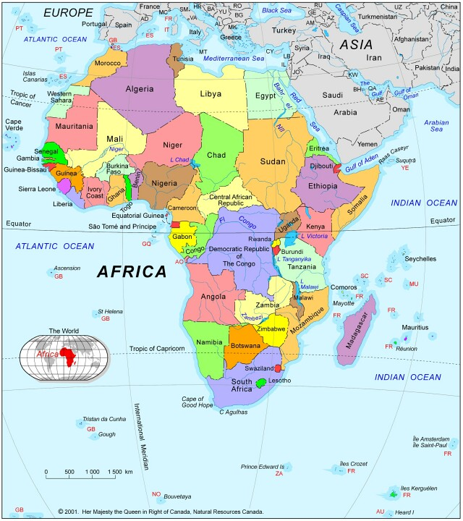
All Africa Sunrise Strategy
All Africa Sunrise Strategy Coordinator
We planned, brought together in D.R. Congo and trained DCI Representatives from 8 different Countries

Slide 319
Central Africa Sunrise Strategy Coordinator
Each DCI Representative will be expected to equip a team of trainers to train enough churches to reach their entire country!

Slide 320
As they are reaching their own country they could train DCI Representatives in 4 to 5 other countries around them to do the same as they are doing!

Slide 321
North East Africa Sunrise Strategy Coordinator
Each of the 8 DCI Representative could reach their own country and 4 to 5 other countries around them!

Slide 322
East Africa Sunrise Strategy Coordinator

Slide 323
South Africa Sunrise Strategy Coordinator

Slide 324
South West Africa Sunrise Strategy Coordinator

Slide 325
North Africa Sunrise Strategy Coordinator

Slide 326
West Africa Sunrise Strategy Coordinator

Slide 327
North West Africa Sunrise Strategy Coordinator
8 Regional Trainers
54 Nations
1 Billion People

Slide 328
Can it be Accomplished?
We believe it not only can, but must be accomplished because God’s mandate is to disciple every nation of the world and thus Fulfill the Great Commission!
We need to be obedient and make disciples.
Jesus promised in Matthew 28:18-20 that as we go and make disciples, “He would be with us right to the very end”!
God’s purpose will be accomplished!!

Slide 329
You and the Great Commission
You and your group can share the gospel with your friends and family. Use “How You Can Become a Child of God” presentation.
Invite those who receive Christ to be discipled. You can order the One-to-One discipleship materials and go through them together. They are available through Dynamic Churches International – or they can be downloaded from our website at: www.dynamicchurches.org
Invite the new Christians to your Small Group.

Slide 330
You and the Great Commission
Your church could adopt the Sunrise Strategy and set goals to reach your neighbourhood and also work with other churches to reach your city and country.
If you need help please contact us at:
Dynamic Churches International. Please visit our website at: www.dynamicchurches.org
or email us at: dcioffice@shaw.ca

Slide 331
Jesus’ Command
“A new command I give you: Love one another. As I have loved you, so you must love one another. By this all men will know that you are my disciples, if you love one another.” John 13:34-35
God’s Command
“And this is His (the Father’s) command: to believe in the name of His Son, Jesus Christ, and to love one another as He (Jesus) com-manded us. 1 John 3:23
The Great Commission
is God’s Strategy
“Therefore go and make disciples of all nations, baptizing them in the name of the Father and the Son and the Holy Spirit, and teaching them to obey everything I have commanded you.” Matthew 28:18-20

Slide 332
Jesus’ Command
Jesus taught us many things, but the only thing that He commanded us to do was: “Love one another. As I have loved you, so you must love one another. By this all men will know that you are My disciples, if you love one another.” John 13:34-35

Slide 333
How Can We Love Other People?
Let Christ be your life and be available for Him to love them through you!
You will experience great joy as you live the life God created you to live!
The Father will see the fullness of His Son in you and be satisfied!

Slide 334
Jesus the Firstborn of Many
“For those God foreknew he also predestined to be conformed to the likeness of his Son, that he might be the firstborn among many brothers. And those he predestined, he also called; those he called, he also justified; those he justified, he also glorified”. Romans 8:29,30

Slide 335
Ultimate Purpose!
There you have the whole story of the Incarnation and the Cross; and there you have the Ultimate Purpose of God fulfilled in His “bringing many sons to glory”. Heb. 2:10
God is seeking full-grown (mature) sons and daughters expressing the fullness of His Son - this is God’s Ultimate Purpose in having many sons and daughters.

Slide 336
Ultimate Purpose!
God bless you as you go and make Disciples!

Slide 337
Pray for Each Other
Prayer:
  Share prayer requests.
  Pray for the needs expressed.
  Pray for those you hope to share Christ with this week.
Pray that God will motivate us to fulfill the great commission in our community and even our country by working together with other churches and mobilizing an army of witnessing disciples!
Our Next Session (If we continue to meet)
Date ______ Time ______ Place ________________

